Slide 1


SuccessFactors Solution Architecture
Markus Platte, SAP
February 19, 2019

Slide 2
Agenda topics
Overall Architecture Design
Cross-module Interactions
Instance Strategy
General Platform Topics
Permission Framework Review
Data Privacy & Retention Strategy
Intelligent Services
Mobile Strategy
Testing Strategy

Slide 3

Overall Architecture Design

Slide 4
System Architecture SuccessFactors

Slide 5
Cross-module Interactions

Slide 6
SuccessFactors Cross-module interactions

Slide 7
SAP SuccessFactors HCM Suite Alignment to Business Value
Business Value
Value outcomes resulting from streamlined processes such as effective talent acquisition, top talent retention, and improved efficiencies
Key Process Interactions
Cross-module set providing synergistic, business value outcomes driven by process
Key Data Interactions
Building blocks that help facilitate the attainment of outcomes

Slide 8
New Hire Life Cycle - HR Calendar Process Clusters
3. Learn & Develop Process
2. Perform & Reward Process
Performance
1. Recruit & Hire Process
January
December January

Slide 9
Employee Lifecycle | Process Value Outcomes
Business Value
Key Process Interactions
Key Data Interactions
Recruiting Marketing
Recruiting Management
Onboarding
Employee Central
Employee Data
Competency Framework
Position Data
Recruit & Hire Process
Attract & hire best candidates
Faster time to new hire value.
New Hire Data
Applicant Data
Requisition Data
Ensure strategy & goal alignment
Continuously improve performance
Pay for performance of top talent
Performance Management
Goal Management
Compensation Management
Variable Pay
Employee Data
Competency Framework
Compensation Data
Perform & Reward Process
Business Goals
Job Data
Performance Data
Learn & Develop Process
Accurately and consistently identify top talent
Provide opportunities for employee growth & development.
Succession Management
Career Development Planning
Learning Management
Employee Data
Competency Framework
Position Data
Development Goals
Learning Content
Performance Data

Slide 10
Cross-Module Interactions: Recruit & Hire Process Review
Value Proposition
Process Flow
Process Interactions
Design Planning
Business Value
Key Process Interactions
Key Data Interactions
Recruiting Marketing
Recruiting Management
Onboarding
Employee Central
Employee Data
Competency Framework
Position Data
Recruit & Hire Process
Attract & hire best candidates
Faster time to new hire value.
New Hire Data
Applicant Data
Requisition Data

Slide 11
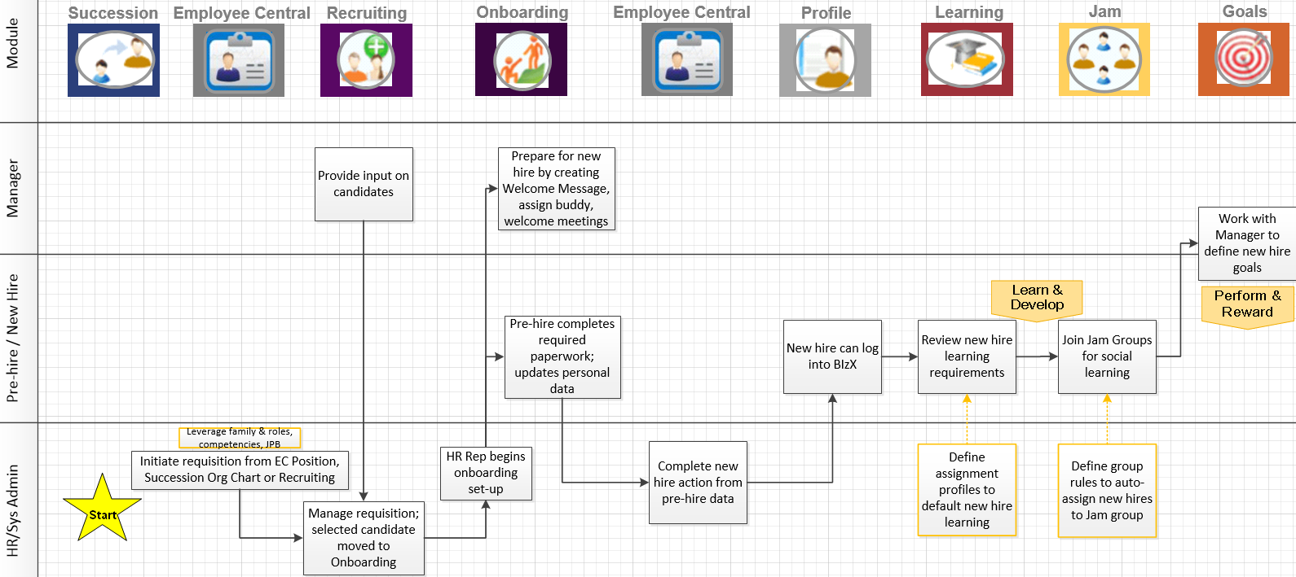
Recruit & Hire Process Flow
Legend
Connection to other Process
Configuration step

Slide 12
Cross-Module Interactions: Recruit & Hire Process Review
Value Proposition
Process Flow
Process Interactions
Design Planning
Business Value
Key Process Interactions
Key Data Interactions
Recruiting Marketing
Recruiting Management
Onboarding
Employee Central
Employee Data
Competency Framework
Position Data
Recruit & Hire Process
Attract & hire best candidates
Faster time to new hire value.
New Hire Data
Applicant Data
Requisition Data

Slide 13

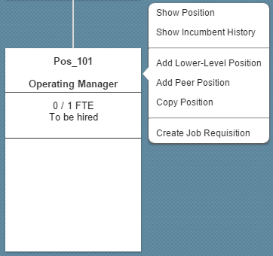






Recruit & Hire Process Interactions
Start
6a
Learning
8
1a
Job requisition can be initiated from Position Org Chart
1b
Employee Central
Recruiting
6b
Learn & Develop
Succession
7
Jam
5
9
4
Onboarding
Employee Profile
Goals
10
Perform & Reward
2
3

Slide 14
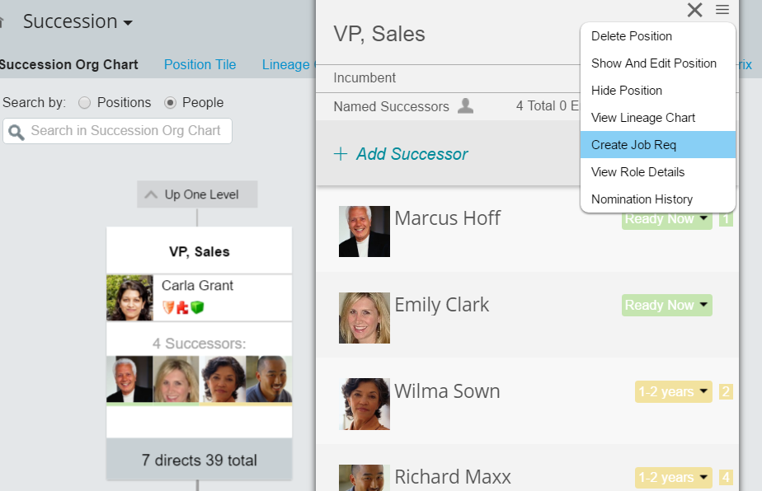
Recruit & Hire Process Interactions
Start
6a
Learning
8
1a
Job requisition can be initiated from Succession Org Chart
Job requisition can be initiated from Position Org Chart
1b
Employee Central
Recruiting
6b
Learn & Develop
Succession
7
Jam
5
9
4
Onboarding
Employee Profile
Goals
10
Perform & Reward
2
3

Slide 15
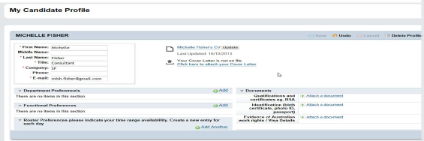
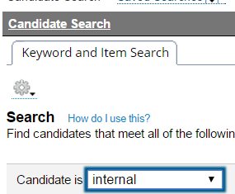
Recruit & Hire Process Interactions
Start
6a
Learning
8
1a
Job requisition can be initiated from Succession Org Chart
Job requisition can be initiated from Position Org Chart
1b
Employee Central
Recruiting
6b
Learn & Develop
Succession
7
Jam
5
9
4
Onboarding
Employee Profile
Goals
10
Perform & Reward
2
Recruiters can search candidates including internal candidate profiles
Employees can update their candidate profile when applying for jobs which also updates their employee profile
3

Slide 16
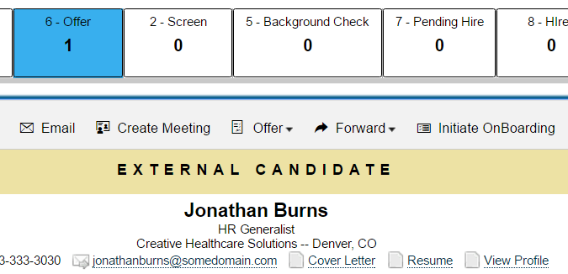
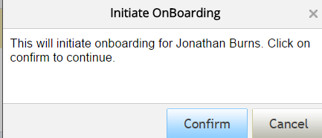
Recruit & Hire Process Interactions
Start
6a
Learning
8
1a
Job requisition can be initiated from Succession Org Chart
Job requisition can be initiated from Position Org Chart
1b
Employee Central
Recruiting
6b
Learn & Develop
Succession
7
Jam
5
9
4
Onboarding
Employee Profile
Initiate onboarding from requisition
Goals
10
Perform & Reward
2
Recruiters can search candidates including internal candidate profiles
Employees can update their candidate profile when applying for jobs which also updates their employee profile
3

Slide 17
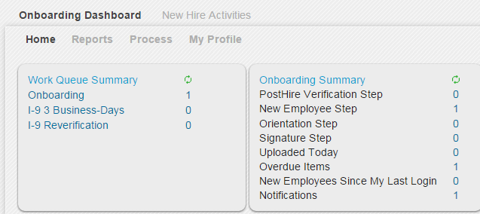
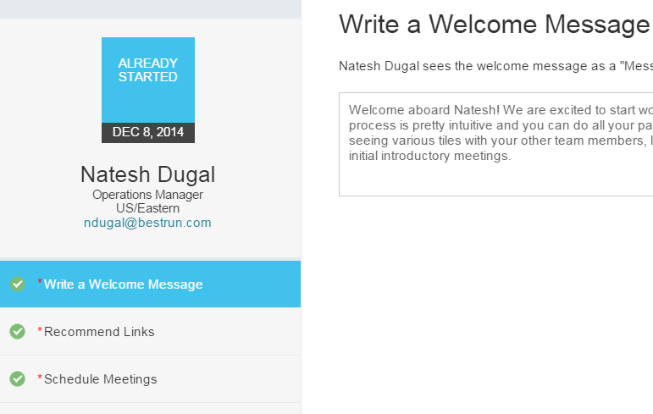
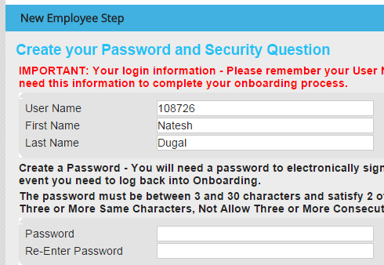
Recruit & Hire Process Interactions
Start
6a
Learning
8
1a
Job requisition can be initiated from Succession Org Chart
Job requisition can be initiated from Position Org Chart
1b
Employee Central
Recruiting
6b
Learn & Develop
Succession
7
Jam
5
9
Complete onboarding tasks
4
Onboarding
Employee Profile
Initiate onboarding from requisition
Goals
10
Perform & Reward
2
Recruiters can search candidates including internal candidate profiles
Employees can update their candidate profile when applying for jobs which also updates their employee profile
3

Slide 18
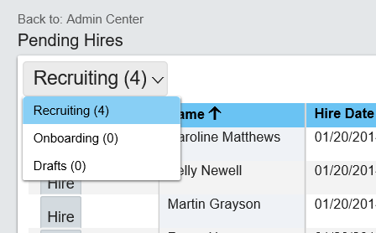
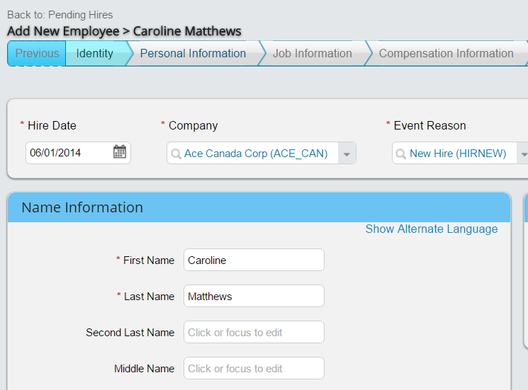
Recruit & Hire Process Interactions
Start
6a
Learning
Pull candidate data to complete new hire
8
1a
Job requisition can be initiated from Succession Org Chart
Job requisition can be initiated from Position Org Chart
1b
Employee Central
Recruiting
6b
Learn & Develop
Pull onboarding data to complete new hire
Succession
7
Jam
5
9
Complete onboarding tasks
4
Onboarding
Employee Profile
Initiate onboarding from requisition
Goals
10
Perform & Reward
2
Recruiters can search candidates including internal candidate profiles
Employees can update their candidate profile when applying for jobs which also updates their employee profile
3

Slide 19
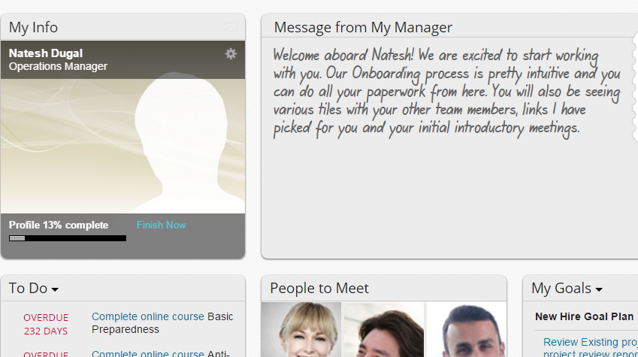
Recruit & Hire Process Interactions
Start
6a
Learning
Pull candidate data to complete new hire
8
1a
Job requisition can be initiated from Succession Org Chart
Job requisition can be initiated from Position Org Chart
1b
Employee Central
Recruiting
6b
Learn & Develop
Pull onboarding data to complete new hire
Succession
7
Jam
New hire can access talent modules
5
9
Complete onboarding tasks
4
Onboarding
Employee Profile
Initiate onboarding from requisition
Goals
10
Perform & Reward
2
Recruiters can search candidates including internal candidate profiles
Employees can update their candidate profile when applying for jobs which also updates their employee profile
3

Slide 20
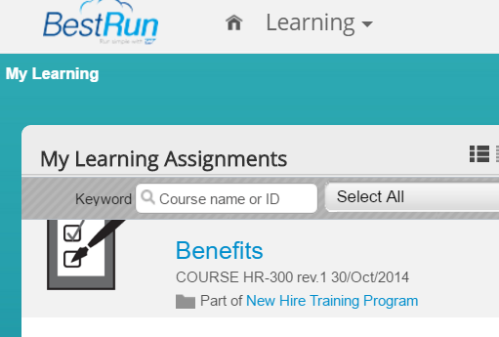
Recruit & Hire Process Interactions
Start
6a
Learning
Pull candidate data to complete new hire
8
Auto assign new hire required learning
1a
Job requisition can be initiated from Succession Org Chart
Job requisition can be initiated from Position Org Chart
1b
Employee Central
Recruiting
6b
Learn & Develop
Pull onboarding data to complete new hire
Succession
7
Jam
New hire can access talent modules
5
9
Complete onboarding tasks
4
Onboarding
Employee Profile
Initiate onboarding from requisition
Goals
10
Perform & Reward
2
Recruiters can search candidates including internal candidate profiles
Employees can update their candidate profile when applying for jobs which also updates their employee profile
3

Slide 21
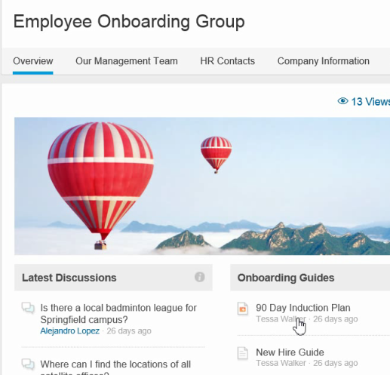
Recruit & Hire Process Interactions
Start
6a
Learning
Pull candidate data to complete new hire
8
Auto assign new hire required learning
1a
Job requisition can be initiated from Succession Org Chart
Job requisition can be initiated from Position Org Chart
1b
Employee Central
Recruiting
6b
Learn & Develop
Pull onboarding data to complete new hire
Succession
7
Jam
New hire can access talent modules
5
9
Auto assign new hire to “new hire” Jam group
Complete onboarding tasks
4
Onboarding
Employee Profile
Initiate onboarding from requisition
Goals
10
Perform & Reward
2
Recruiters can search candidates including internal candidate profiles
Employees can update their candidate profile when applying for jobs which also updates their employee profile
3

Slide 22
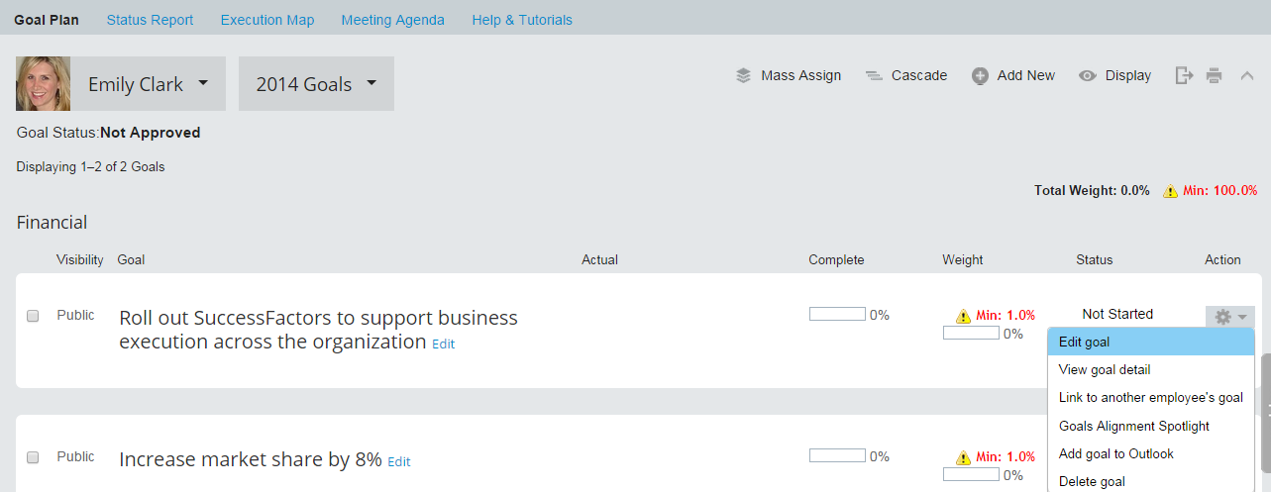
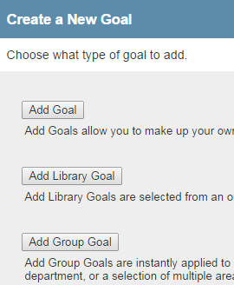
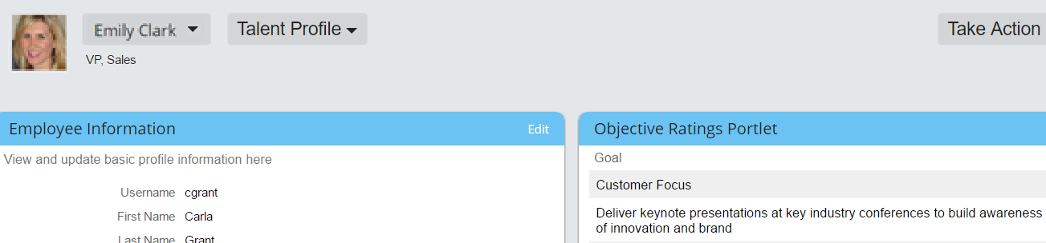
Recruit & Hire Process Interactions
Start
6a
Learning
Pull candidate data to complete new hire
8
Auto assign new hire required learning
1a
Job requisition can be initiated from Succession Org Chart
Job requisition can be initiated from Position Org Chart
1b
Employee Central
Recruiting
6b
Learn & Develop
Pull onboarding data to complete new hire
Succession
7
Jam
New hire can access talent modules
5
9
Auto assign new hire to “new hire” Jam group
Complete onboarding tasks
4
Onboarding
Employee Profile
Initiate onboarding from requisition
Goals
10
Create new hire goals
Perform & Reward
2
Recruiters can search candidates including internal candidate profiles
Employees can update their candidate profile when applying for jobs which also updates their employee profile
3

Slide 23
Cross-Module Interactions: Perform & Reward Process Review
Value Proposition
Process Flow
Process Interactions
Design Planning
Business Value
Key Process Interactions
Key Data Interactions
Ensure strategy & goal alignment
Continuously improve performance
Pay for performance of top talent
Performance Management
Goal Management
Compensation Management
Variable Pay
Employee Data
Competency Framework
Compensation Data
Perform & Reward Process
Business Goals
Job Data
Performance Data

Slide 24
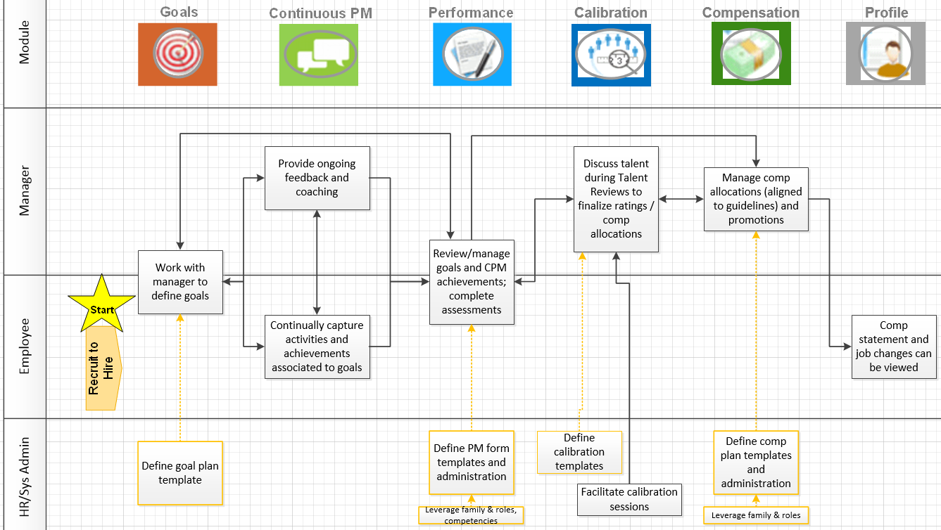
Perform & Reward Process Flow
Legend
Connection to other Process
Configuration step

Slide 25
Cross-Module Interactions: Perform & Reward Process Review
Value Proposition
Process Flow
Process Interactions
Design Planning
Business Value
Key Process Interactions
Key Data Interactions
Ensure strategy & goal alignment
Continuously improve performance
Pay for performance of top talent
Performance Management
Goal Management
Compensation Management
Variable Pay
Employee Data
Competency Framework
Compensation Data
Perform & Reward Process
Business Goals
Job Data
Performance Data

Slide 26
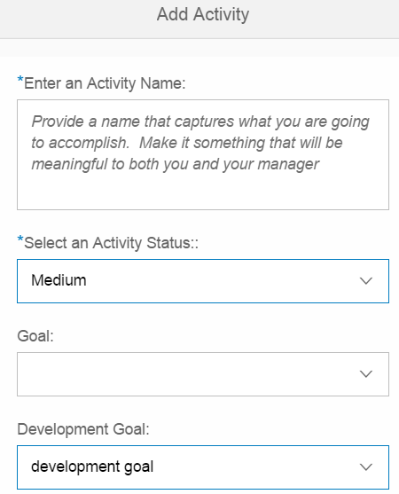



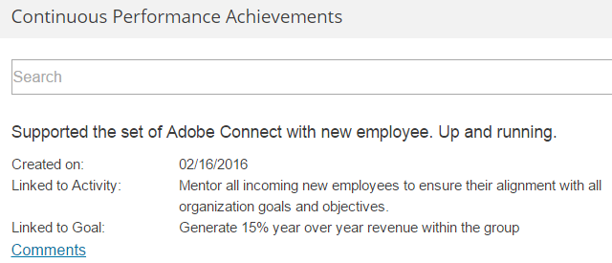
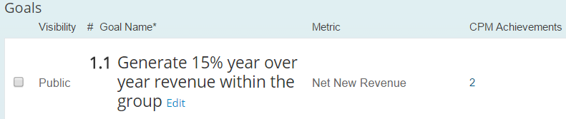
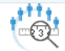
Perform & Reward Process Interactions
1a
Goals are created
Goals
Employee Profile
Recruit to Hire
Start
2
4b
3
1b
6
Employee Profile
Link CPM Achievements and/or Activities to Goals
Continuous PM
4a
Compensation
Performance
Employee Profile serves as a central repository for all talent data (all modules feed back to EP)
Employee Central
5
Learn & Develop
Calibration
Notes:
Connection Points

Slide 27
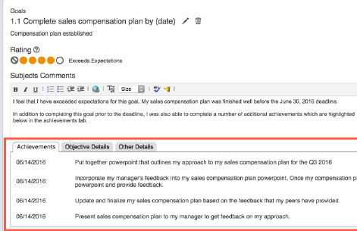
Perform & Reward Process Interactions
Goals
Employee Profile
Recruit to Hire
Start
2
4b
Review/manage goals during PM review
3
1
Link CPM activities to goals
View achievements tied to goals in PM
6
Employee Profile
Continuous PM
4a
Compensation
Performance
Employee Profile serves as a central repository for all talent data (all modules feed back to EP)
Employee Central
5
Learn & Develop
Calibration
Notes:
Connection Points

Slide 28
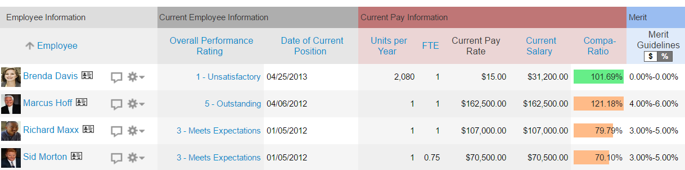
Perform & Reward Process Interactions
Goals
Employee Profile
Recruit to Hire
Start
2
4b
Review/manage goals during PM review
3
1
Link CPM activities to goals
View achievements tied to goals in PM
6
Employee Profile
Continuous PM
4a
Review comp guidelines driven by PM ratings
Compensation
Performance
Employee Profile serves as a central repository for all talent data (all modules feed back to EP)
Employee Central
5
Learn & Develop
Calibration
Notes:
Connection points and example

Slide 29
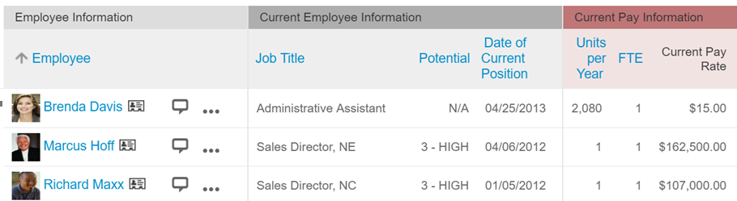
Perform & Reward Process Interactions
Goals
Employee Profile
Review comp guidelines driven by ratings stored on EP
Recruit to Hire
Start
2
4b
Review/manage goals during PM review
3
1
Link CPM activities to goals
View achievements tied to goals in PM
6
Employee Profile
Continuous PM
4a
Review comp guidelines driven by PM ratings
Compensation
Performance
Employee Profile serves as a central repository for all talent data (all modules feed back to EP)
Employee Central
5
Learn & Develop
Calibration
Notes:
Connection points and example

Slide 30
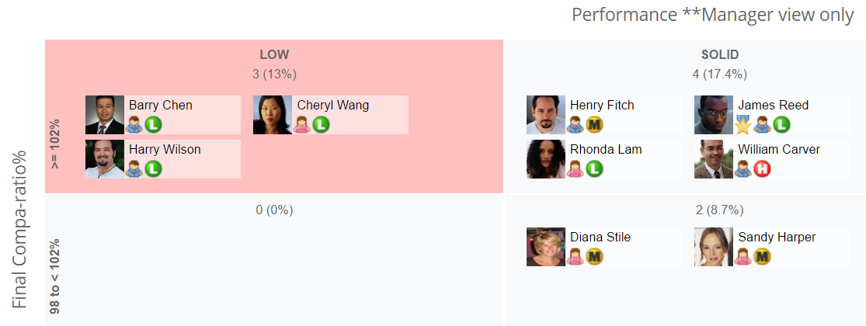
Perform & Reward Process Interactions
Goals
Employee Profile
Review comp guidelines driven by ratings stored on EP
Recruit to Hire
Start
2
4b
Review/manage goals during PM review
3
1
Link CPM activities to goals
View achievements tied to goals in PM
6
Employee Profile
Continuous PM
4a
Review comp guidelines driven by PM ratings
Compensation
Performance
Employee Profile serves as a central repository for all talent data (all modules feed back to EP)
Employee Central
5
Calibrate ratings, compensation data
Learn & Develop
Calibration
Notes:
Connection Points and example

Slide 31
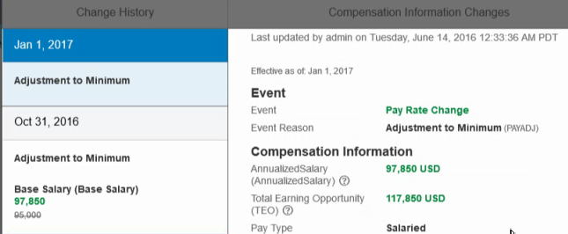
Perform & Reward Process Interactions
Goals
Employee Profile
Review comp guidelines driven by ratings stored on EP
Recruit to Hire
Start
2
4b
Review/manage goals during PM review
3
1
Link CPM activities to goals
View achievements tied to goals in PM
6
Employee Profile
Continuous PM
4a
Review comp guidelines driven by PM ratings
Compensation
Manage comp distributions for merit, bonus, equity; enter promotions as part of planning
Performance
Employee Profile serves as a central repository for all talent data (all modules feed back to EP)
Employee Central
5
Calibrate ratings, compensation data
Learn & Develop
Calibration

Slide 32

Perform & Reward Process Interactions
Goals
Employee Profile
Review comp guidelines driven by ratings stored on EP
Recruit to Hire
Start
2
4b
Review/manage goals during PM review
3
1
Link CPM activities to goals
View achievements tied to goals in PM
Employee Profile
6a
Continuous PM
4a
Review comp guidelines driven by PM ratings
Compensation
Final Pay elements and promotion to EC
Performance
Employee Profile serves as a central repository for all talent data (all modules feed back to EP)
Employee Central
5
Calibrate ratings, compensation data
Learn & Develop
Calibration
Variable Pay
Publish final calculated bonus amount from VP to EC
6b
Notes:
Connection Points and examples

Slide 33
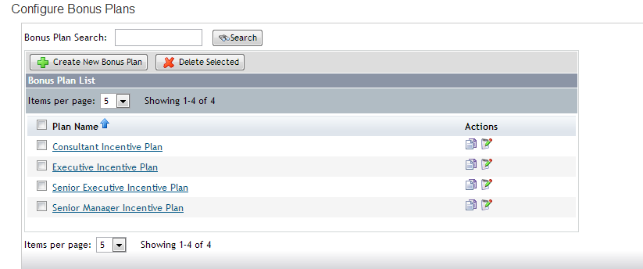
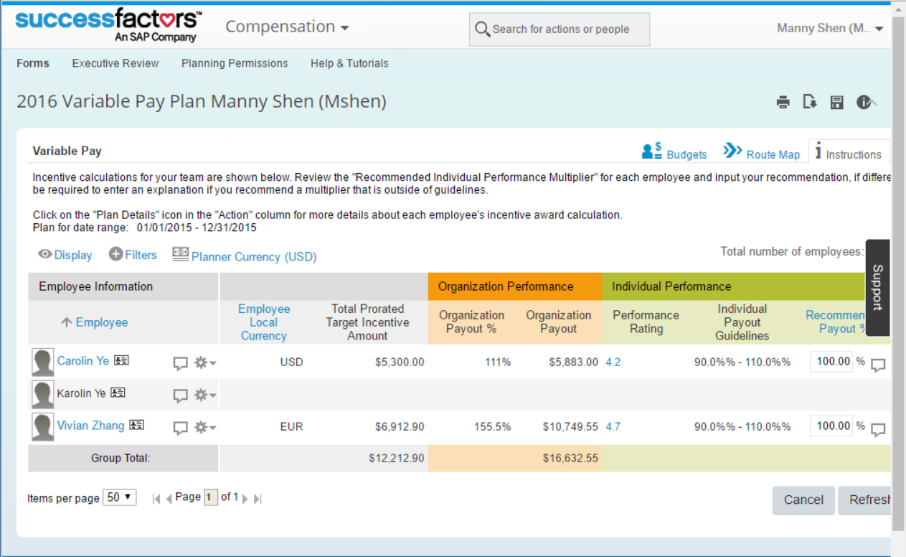
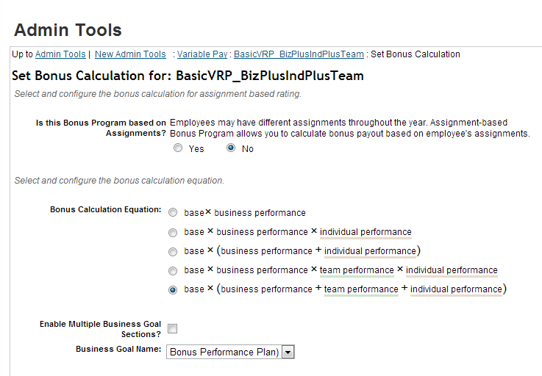
Perform & Reward Process Interactions
Business goals and weights to VP
Variable Pay
7
Goals
Notes:
Connection points and example

Slide 34
Cross-Module Interactions: Learn & Develop Process Review
Value Proposition
Process Flow
Process Interactions
Design Planning
Business Value
Key Process Interactions
Key Data Interactions
Learn & Develop Process
Accurately and consistently identify top talent
Provide opportunities for employee growth & development.
Succession Management
Career Development Planning
Learning Management
Employee Data
Competency Framework
Position Data
Development Goals
Learning Content
Performance Data

Slide 35
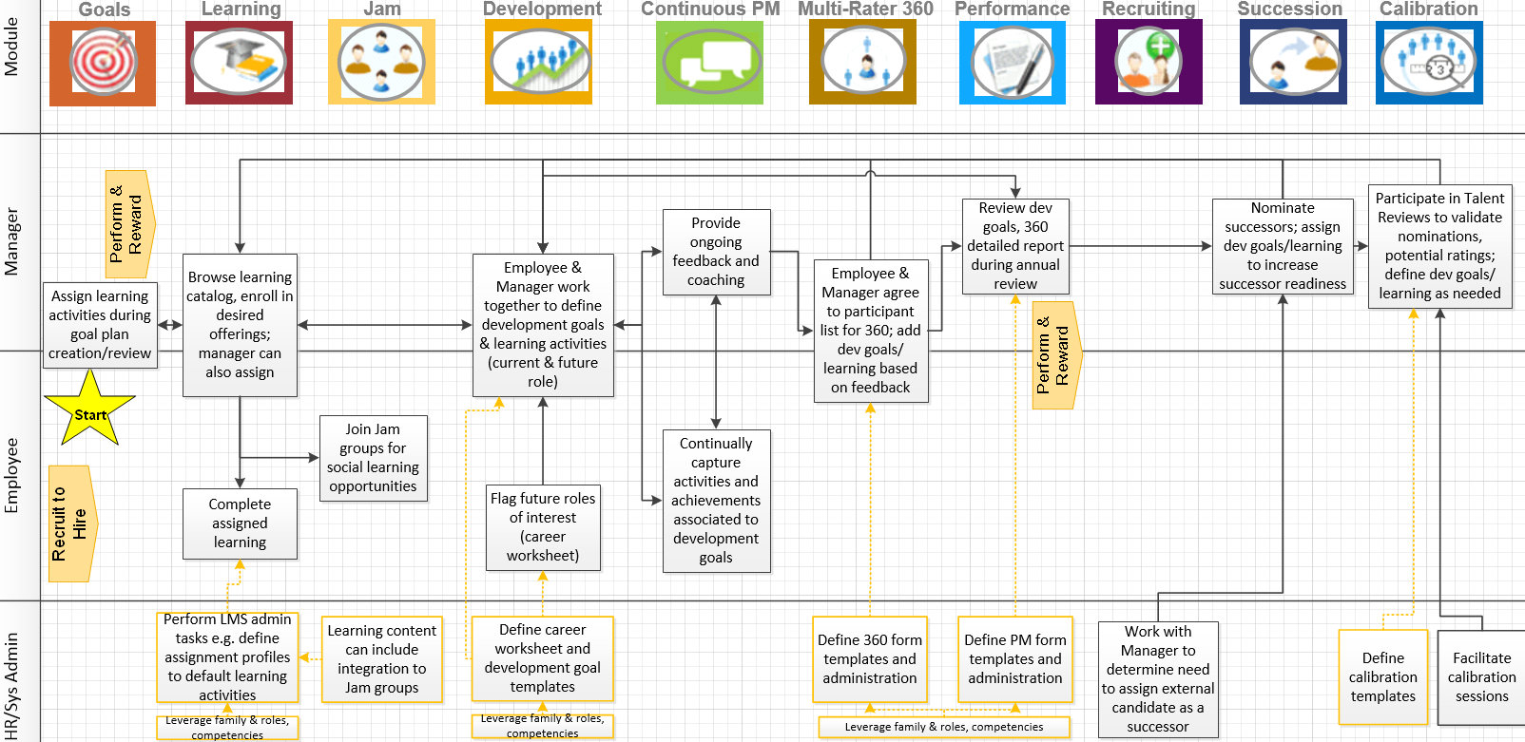
Learn & Develop Process Flow
Legend
Connection to other Process
Configuration step
Notes:
Learn & develop is a continual process – for illustration purposes may appear like linear flow

Slide 36
Cross-Module Interactions: Learn & Develop Process Review
Value Proposition
Process Flow
Process Interactions
Design Planning
Business Value
Key Process Interactions
Key Data Interactions
Learn & Develop Process
Accurately and consistently identify top talent
Provide opportunities for employee growth & development.
Succession Management
Career Development Planning
Learning Management
Employee Data
Competency Framework
Position Data
Development Goals
Learning Content
Performance Data

Slide 37
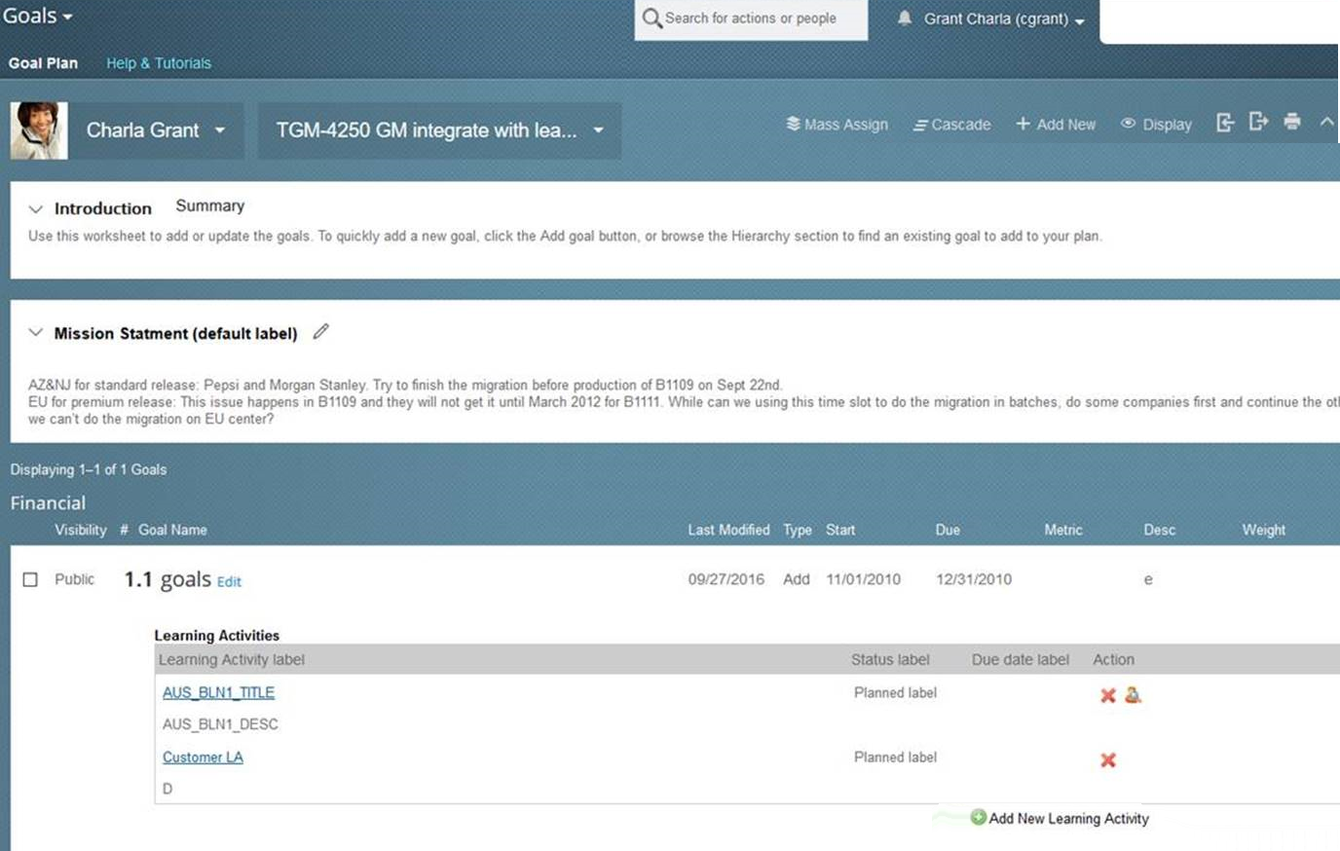
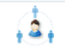

Learn & Develop Process Interactions
Perform & Reward
Continuous PM
Perform & Reward
Performance
4b
Goals
Recruit to Hire
Goals
3
5b
5a
Multi-Rater 360
Employee Profile
1
Add learning activity
Start
2
4a
Learning
Development
7b
Employee Profile serves as a central repository for all talent data (all modules feed back to EP)
6b
Calibration
7a
11
6a
Succession
9
8
Jam
Employee Central
Employee Profile
10
Recruiting

Slide 38
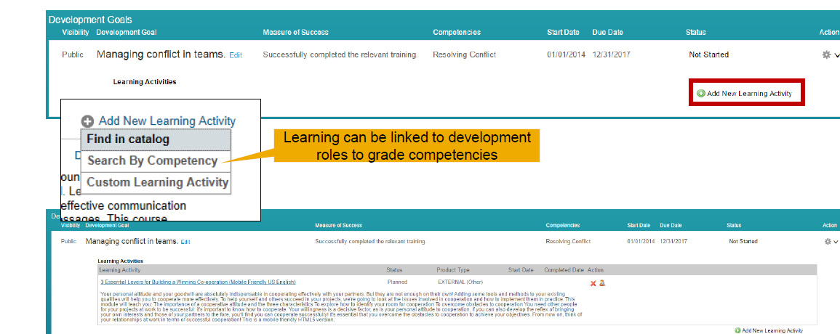
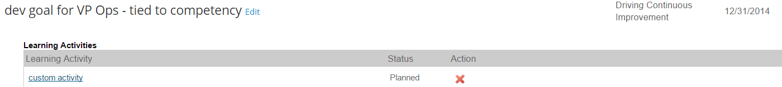
Learn & Develop Process Interactions
Perform & Reward
Continuous PM
Perform & Reward
Performance
4b
Goals
Recruit to Hire
Goals
3
5b
5a
Multi-Rater 360
Employee Profile
1
Add learning activity
Start
2
Select from learning when defining development goals
4a
Learning
Development
7b
Employee Profile serves as a central repository for all talent data (all modules feed back to EP)
6b
Calibration
7a
11
6a
Succession
9
8
Jam
Employee Central
Employee Profile
10
Recruiting

Slide 39
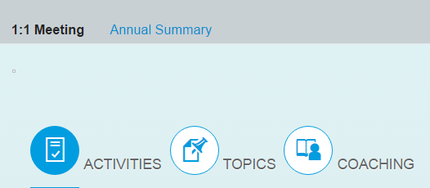
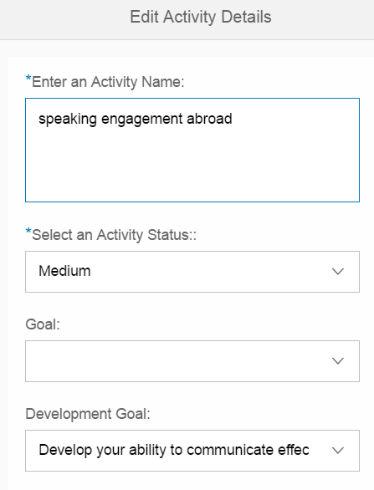
Learn & Develop Process Interactions
Perform & Reward
Continuous PM
Perform & Reward
Performance
4b
Goals
Recruit to Hire
Goals
3
5b
Link CPM activities to development goals
5a
Multi-Rater 360
Employee Profile
1
Add learning activity
Start
2
Select from learning when defining development goals
4a
Learning
Development
7b
Employee Profile serves as a central repository for all talent data (all modules feed back to EP)
6b
Calibration
7a
11
6a
Succession
9
8
Jam
Employee Central
Employee Profile
10
Recruiting

Slide 40
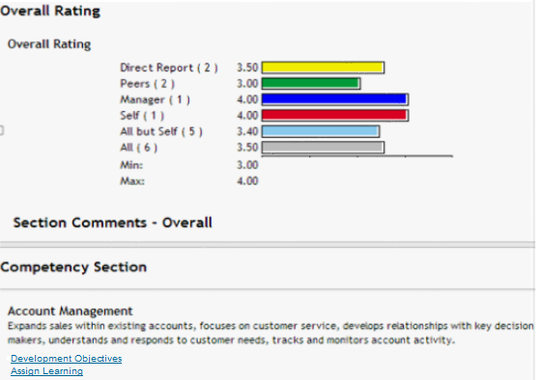
Learn & Develop Process Interactions
Perform & Reward
Continuous PM
Perform & Reward
Performance
4b
Goals
Recruit to Hire
Goals
3
5b
Link CPM activities to development goals
5a
Multi-Rater 360
Employee Profile
1
Add learning activity
Start
2
Select from learning when defining development goals
4a
Add development goals from 360 Report
Learning
Development
7b
Employee Profile serves as a central repository for all talent data (all modules feed back to EP)
6b
Calibration
7a
11
6a
Succession
9
8
Jam
Employee Central
Employee Profile
10
Recruiting

Slide 41
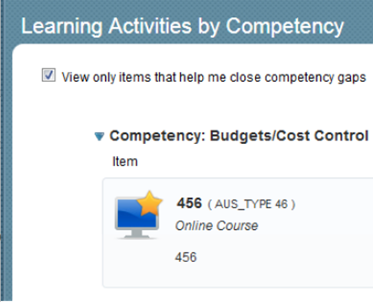
Learn & Develop Process Interactions
Perform & Reward
Continuous PM
Perform & Reward
Performance
4b
Goals
Add learning activity from 360 Report
Recruit to Hire
Goals
3
5b
Link CPM activities to development goals
5a
Multi-Rater 360
Employee Profile
1
Add learning activity
Start
2
Select from learning when defining development goals
4a
Add development goals from 360 Report
Learning
Development
7b
Employee Profile serves as a central repository for all talent data (all modules feed back to EP)
6b
Calibration
7a
11
6a
Succession
9
8
Jam
Employee Central
Employee Profile
10
Recruiting

Slide 42
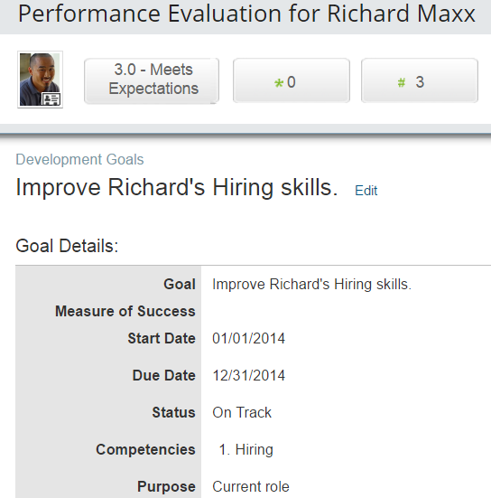
Learn & Develop Process Interactions
Perform & Reward
Continuous PM
Perform & Reward
Performance
4b
Goals
Add learning activity from 360 Report
Recruit to Hire
Goals
3
5b
Link CPM activities to development goals
5a
Multi-Rater 360
Add learning activity
Review development goals during PM review
Employee Profile
1
2
Select from learning when defining development goals
Start
4a
Add development goals from 360 Report
Learning
Development
7b
Employee Profile serves as a central repository for all talent data (all modules feed back to EP)
6b
Calibration
7a
11
6a
Succession
9
8
Jam
Employee Central
Employee Profile
10
Recruiting

Slide 43
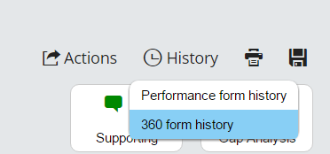
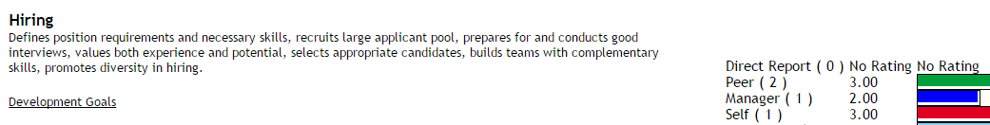
Learn & Develop Process Interactions
Perform & Reward
Continuous PM
Perform & Reward
Performance
4b
Goals
Add learning activity from 360 Report
Goals
3
Review Detailed 360 Report during PM review
Recruit to Hire
5b
Link CPM activities to development goals
5a
Multi-Rater 360
Add learning activity
Review development goals during PM review
Employee Profile
1
2
Select from learning when defining development goals
Start
4a
Add development goals from 360 Report
Learning
Development
7b
Employee Profile serves as a central repository for all talent data (all modules feed back to EP)
6b
Calibration
7a
11
6a
Succession
9
8
Jam
Employee Central
Employee Profile
10
Recruiting

Slide 44
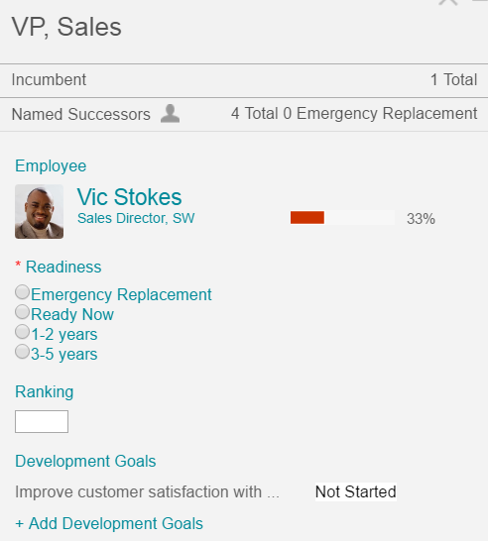
Learn & Develop Process Interactions
Perform & Reward
Continuous PM
Perform & Reward
Performance
4b
Goals
Add learning activity from 360 Report
Goals
3
Review Detailed 360 Report during PM review
Recruit to Hire
5b
Link CPM activities to development goals
5a
Multi-Rater 360
Add learning activity
Review development goals during PM review
Employee Profile
1
2
Select from learning when defining development goals
Start
4a
Add development goals from 360 Report
Learning
Development
7b
Employee Profile serves as a central repository for all talent data (all modules feed back to EP)
6b
Calibration
Add dev goals
7a
11
6a
Succession
9
8
Jam
Employee Central
Employee Profile
10
Recruiting

Slide 45
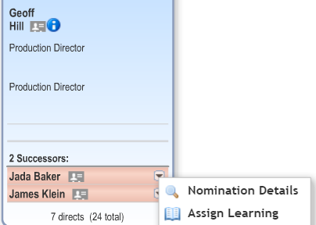
Learn & Develop Process Interactions
Perform & Reward
Continuous PM
Perform & Reward
Performance
4b
Goals
Add learning activity from 360 Report
Goals
3
Review Detailed 360 Report during PM review
Recruit to Hire
5b
Link CPM activities to development goals
5a
Multi-Rater 360
Add learning activity
Review development goals during PM review
Employee Profile
1
2
Select from learning when defining development goals
Start
4a
Add development goals from 360 Report
Learning
Development
Add learning activity
7b
Employee Profile serves as a central repository for all talent data (all modules feed back to EP)
6b
Calibration
Add dev goals
7a
11
6a
Succession
9
8
Jam
Employee Central
Employee Profile
10
Recruiting

Slide 46
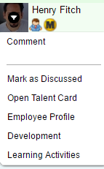
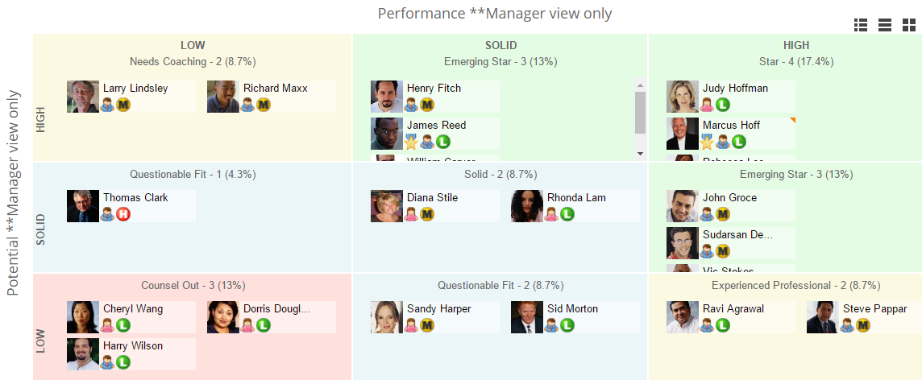
Learn & Develop Process Interactions
Perform & Reward
Continuous PM
Perform & Reward
Performance
4b
Goals
Add learning activity from 360 Report
Goals
3
Review Detailed 360 Report during PM review
Recruit to Hire
5b
Link CPM activities to development goals
5a
Multi-Rater 360
Add learning activity
Review development goals during PM review
Employee Profile
1
2
Select from learning when defining development goals
Start
4a
Add development goals from 360 Report
Learning
Development
Add learning activity
7b
Employee Profile serves as a central repository for all talent data (all modules feed back to EP)
6b
Calibration
7a
Add development goals during session
Add dev goals
11
6a
Succession
9
8
Jam
Employee Central
Employee Profile
10
Recruiting

Slide 47
Learn & Develop Process Interactions
Perform & Reward
Continuous PM
Perform & Reward
Performance
4b
Goals
Add learning activity from 360 Report
Goals
3
Review Detailed 360 Report during PM review
Recruit to Hire
5b
Link CPM activities to development goals
5a
Multi-Rater 360
Add learning activity
Review development goals during PM review
Employee Profile
1
2
Select from learning when defining development goals
Start
4a
Add development goals from 360 Report
Learning
Development
Add learning activity
7b
Employee Profile serves as a central repository for all talent data (all modules feed back to EP)
6b
Calibration
Add learning activity during session
7a
Add development goals during session
Add dev goals
11
6a
Succession
9
8
Jam
Employee Central
Employee Profile
10
Recruiting

Slide 48
Learn & Develop Process Interactions
Perform & Reward
Continuous PM
Perform & Reward
Performance
4b
Goals
Add learning activity from 360 Report
Goals
3
Review Detailed 360 Report during PM review
Recruit to Hire
5b
Link CPM activities to development goals
5a
Multi-Rater 360
Add learning activity
Review development goals during PM review
Employee Profile
1
2
Select from learning when defining development goals
Start
4a
Add development goals from 360 Report
Learning
Development
Add learning activity
7b
Employee Profile serves as a central repository for all talent data (all modules feed back to EP)
6b
Calibration
Add learning activity during session
7a
Add development goals during session
Add dev goals
11
6a
Succession
9
8
Jam
Calibrate Succession Data
Employee Central
Employee Profile
10
Recruiting

Slide 49
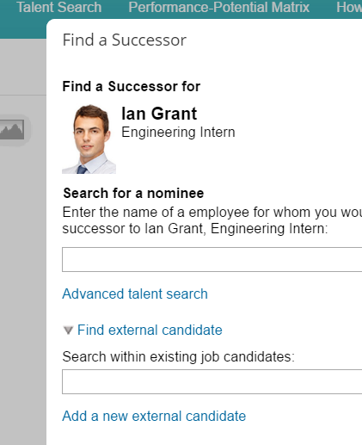
Learn & Develop Process Interactions
Perform & Reward
Continuous PM
Perform & Reward
Performance
4b
Goals
Add learning activity from 360 Report
Goals
3
Review Detailed 360 Report during PM review
Recruit to Hire
5b
Link CPM activities to development goals
5a
Multi-Rater 360
Add learning activity
Review development goals during PM review
Employee Profile
1
2
Select from learning when defining development goals
Start
4a
Add development goals from 360 Report
Learning
Development
Add learning activity
7b
Employee Profile serves as a central repository for all talent data (all modules feed back to EP)
6b
Calibration
Add learning activity during session
7a
Add development goals during session
Add dev goals
11
6a
Succession
9
8
Jam
Nominate external candidates
Calibrate Succession Data
Employee Central
Employee Profile
10
Recruiting

Slide 50
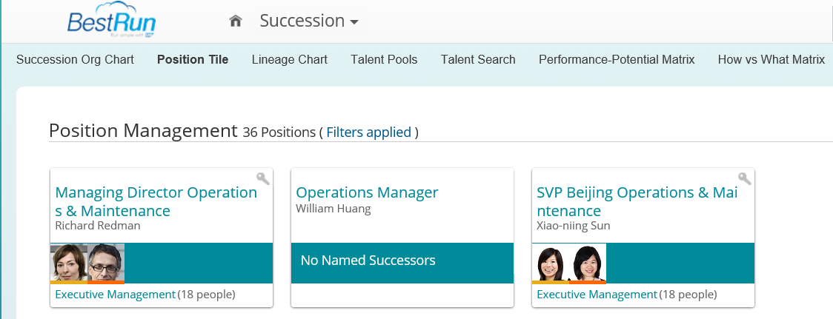
Learn & Develop Process Interactions
Perform & Reward
Continuous PM
Perform & Reward
Performance
4b
Goals
Add learning activity from 360 Report
Goals
3
Review Detailed 360 Report during PM review
Recruit to Hire
5b
Link CPM activities to development goals
5a
Multi-Rater 360
Add learning activity
Review development goals during PM review
Employee Profile
1
2
Select from learning when defining development goals
Start
4a
Add development goals from 360 Report
Learning
Development
Add learning activity
7b
Employee Profile serves as a central repository for all talent data (all modules feed back to EP)
6b
Calibration
Add learning activity during session
7a
Add development goals during session
Add dev goals
11
6a
Succession
9
8
Jam
Nominate external candidates
Calibrate Succession Data
Employee Central
Employee Profile
10
Recruiting
Manage succession plans at position level (optional)

Slide 51
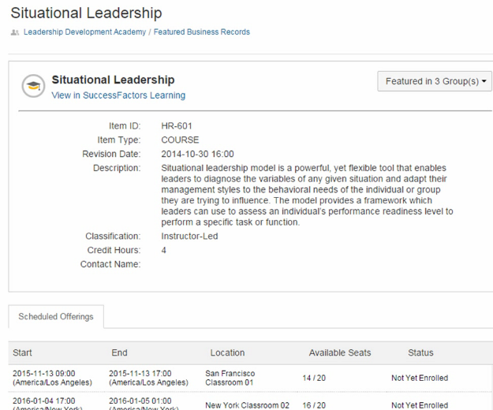

Learn & Develop Process Interactions
Perform & Reward
Continuous PM
Perform & Reward
Performance
4b
Goals
Add learning activity from 360 Report
Goals
3
Review Detailed 360 Report during PM review
Recruit to Hire
5b
Link CPM activities to development goals
5a
Multi-Rater 360
Add learning activity
Review development goals during PM review
Employee Profile
1
2
Select from learning when defining development goals
Start
4a
Add development goals from 360 Report
Learning
Development
Add learning activity
7b
Employee Profile serves as a central repository for all talent data (all modules feed back to EP)
6b
Calibration
Add learning activity during session
7a
Add development goals during session
Join a Jam group associated to a learning course
Add dev goals
11
6a
Succession
9
8
Jam
Nominate external candidates
Calibrate Succession Data
Employee Central
Employee Profile
10
Recruiting
Manage succession plans at position level (optional)

Slide 52
Instance Strategy

Slide 53
Instance Strategy Development Setting the Stage
Instance strategy is an important element in your project planning to effectively manage the multiple streams of work being done to maintain and implement your SAP Cloud solution.
At a high level, it involves the maintenance of a client’s instances from a configuration, data, and testing perspective. The reason Instance Strategy is critical in ensuring successful management of the application because it will impact the timing of projects or critical business processes.
An effective Instance Strategy provides a means for:
Allowing for the evaluation and regression testing of new features and releases before they move into Production
Ensuring smooth configuration and implementation of “phased” projects for multiple modules
Allowing testing of functionality and processes with company data
Addressing testing for SSO and preventing impact to project timelines
Supporting Parallel Testing (if needed for a Payroll integration)
Addressing and testing production issues

Slide 54
Instance Strategy Considerations Recommended Landscape Architecture
The approaches recommended in the following slides are based on the following tenets:
Preview release was designed with these migration paths in mind as leading practice
Allows testing of releases 30 days in advance of hitting production to gain familiarity with new features for adoption and testing
Aligned with Operation philosophy for instance strategy and quality cloud service
Large scale project experience has validated these approaches as leading practice

Slide 55
Instance Strategy Considerations Recommended Landscape Architecture (Without EC)
NOTE: Pay close attention to project timelines and release dates overlapping. Evaluation and migration of new features to Production may affect implementation project timelines.
*PREVIEW STACK
(DC# Preview)
PRODUCTION STACK
(DC# Production)
Preview
Production
*Quarterly releases delivered 30-days before Production
Preview Instance
Used for development, testing & approving configurations
Migration path from Preview to Production
Possibly connected to third party applications for end-to-end testing
Data can be loaded and/or refreshed from Production (may require data scrambling)
Used for testing/support of Production escalations
May include additional features evaluated for implementation in Production
Production Instance
Environment for all live transaction and data management
Connected/integrated to all third party applications
24 x 7 x 365 uptime requirement per SLA’s

Slide 56
Instance Strategy Considerations Recommended Landscape Architecture (With EC)
NOTE: Pay close attention to project timelines and release dates overlapping. Evaluation and migration of new features to Production may affect implementation project timelines.
*PREVIEW STACK
(DC# Preview)
PRODUCTION STACK
(DC# Production)
Preview
Production
Production Instance
Environment for all live transaction and data management
Connected/integrated to all 3rd party application
24 x 7 x 365 uptime requirement per SLA’s
Data Refresh
Migration Path
Production Issues Migration Path
*Quarterly releases delivered 30-days before Production
Quality Assurance
QA Instance
Used for testing and approving configurations
Connected to all third party applications for end-to-end testing
Data should be refreshed from Production (may require data scrambling)
Configurations are migrated from Preview upon approvals
Used for testing/support of Production escalations
Preview Instance
Used for testing & approving configurations
Migration path from Preview to Quality Assurance
Possibly connected to third party applications for end-to-end testing
Data can be loaded and/or refreshed from Production (may require data scrambling)
Used for testing/support of Production escalations
May include additional features evaluated for implementation in Production

Slide 57
Instance Strategy Considerations Leading Practice Applied to Client Example (with EC)
*PREVIEW STACK
(DC4 Preview)
Instance Refresh post go live
PRODUCTION STACK
(DC4 Production)
Instance: clientnameDev
Preview
Instance: clientnameProd
Production
BizX
RMK
JAM
BizX
RMK
JAM
ONB
LMS
**WFA
ONB
LMS
WFA
*Receives quarterly releases 30 days in advance of Production Stack
**Client may leverage a demo cube for WFA in preview stack (optional)
Migrate configuration after completion of UAT
Migrate configuration into QA instances for UAT when code release is in parity.
Instance: clientnameQA
Quality Assurance
BizX
RMK
JAM
ONB
LMS
Note that there is little benefit in having a QA instance of WFA as the effort to maintain this instance is not worth the value derived in its use.

Slide 58
Instance Strategy Considerations Justifications of Additional Instances Use
When implementing multiple modules over a phased timeline
When deploying staggered global go-lives that have different localization requirements, i.e. Employee Central or Employee Central Payroll
When implementing modules where real confidential data is required to conduct testing and/or training
Where compliance with IT Release Risk Management policies and/or enhanced test routines is required
Where customers perform a high level of self service configuration changes and upgrades of new functionality
Sandbox environments – used for research and other preliminary activities prior to making changes in Development
For a similarly tiered landscape to match the client’s ERP landscape and payroll testing
Data migration environments – used solely for practicing data loads without frequent configuration changes adding complexities
Training environments – used as a dedicated instance of end user training activities, when the volume of such activities warrants a separate environment
Secondary testing environments (e.g. Cutover Test, Integration Test, Pre-Production) – used for conducting targeted, isolated tests, generally as part of the final stages prior to a production cutover

Slide 59
Instance Strategy Considerations Caveats of Additional Instances
Consider that the more instances in use requires more work to maintain consistent configuration setup and to keep the data up to date.
Additional instance maintenance, update and testing can potentially result in additional time requirement for project duration
If the client requires additional configuration efforts to be done in the additional environment, it is subject to resource availability and additional fee applies as well
It is typically the client’s responsibility to maintain any additional instance unless contract specifies otherwise – since customer does not have provisioning access required for various configuration tasks this will mean some requests for change would be done by SuccessFactors.

Slide 60
Instance Strategy Considerations Instance Management Tools
Instance Sync
Provides *selected “configuration push” from one instance to another
*Does not fully support all configuration types currently
Instance Clone
New target Instance with complete copy from existing source instance
Instance Refresh
Complete overwrite of existing target with existing source instance

Slide 61
Instance Strategy Considerations Process of Requesting an Instance Clone/Refresh
Customer to complete refresh request
SAP to file an internal request for Instance Refresh
SAP to take 2 weeks to perform the Instance Refresh from the Source Instance to the Target Instance.
Customer and SAP to jointly arrive at the checklist for the activities to be performed post the instance refresh.
Perform activities post the Instance Refresh in the Target Environment (~2 to 3 weeks).

Slide 62
Instance Strategy Considerations Governance
Maintaining multiple instances successfully will require collaboration between several teams. To ensure that everyone stays “in the loop,” a system governance team is strongly recommended.
Successful system governance reaches well beyond client team admins. Consider including representatives such as HR program managers and process owners, HRIS management, IT professionals and Helpdesk representatives.
System governance teams should meet on a regular basis; quarterly is recommended as a leading practice.
Instance-management discussion topics often include
HR program and system project review – what is currently happening/upcoming for each instance
System release notes review
Refresh frequency and timing
Data integrity practices
Instance user-access, data privacy and permissions

Slide 63
Summary Instance Strategy
Instance Strategy development is critical to the success of any implementation. The strategy must be designed, socialized, and agreed upon at the project onset to establish an adequate landscape and collective understanding of its use.
In general, the following key focus areas for Instance Strategy design are of great importance to any project’s success:
Start planning early – do not wait until project kickoff
Understand the IT protocol/audit policies for the organization
Gain familiarity with the SuccessFactors distinct platforms and terminology
Document the required alignment of the SuccessFactors landscape to the client’s ERP landscape
Know the requirements for the testing approach, mock cutovers, data loading trials, etc.
Involve the key stakeholders in documenting landscape needs and expectations
Notes:
Purpose of this page is to summarize key decisions customer has to make

Slide 64
General Platform Topics

Slide 65

Person ID, User ID, and Username – EC (Standard)
Person-id-external(person ID) – stored in biographical portlet.
UserId – stored on the basic user import.
Username – stored on the basic user import.
When someone is hired in Employee Central, the system automatically assigns a number to the new employee. This is called person-id-external in the system, but labelled Person ID on the UI.
The system also sets the user name and the user ID to the same value as the person ID.
UserId – This is unique number in the system for a user and can’t be changed. Once this value has been used, it can’t be reused. Its sole purpose is to be the system’s unique identifier for the persons employment and is mapped from the Person ID for EC customers.
Username – This is the field that a user uses to sign in and for SSO. It can be different from User ID or Person ID but for simplicity it is often the same value.

Slide 66

User Concept with Concurrent Employments How does it look like?

Slide 67

Architecture Overview
Global Assignments is using the EC data model shown below. The most important objects are listed in this figure. The blue colored objects belong to the Person. Green colored objects indicate Employment specific data. Red colored objects are Foundation objects.

Slide 68

Employee Record with Global Assignment
As an example, the Home and Host users_sys_id related to one person
Fields that may be used for Global Assignments:
is_host_assignment (Flags the employment as Global Assignment)
assignment-type (Usually configured as customizable picklist. It specifies the kind of global assignment. Typical values for Global Assignment Types are “Long Term Assignment” or “Short Term Assignment”)
planned-end-date (Date on which the Global Assignment is supposed to be ended)
end-date (Actual end date, entered at end of global assignment.)
payroll-end-date (Date of last payroll for global assignment.)
Custom fields:
custom-string101–115 and custom-string116–120
custom-date31–35 and custom-date36–40
custom-long21–25 and custom-long26–30
custom-double21–25 and custom-double26–30
NOTE: The first 5 custom field numbers are used to add a global assignment, the last 5 custom field numbers are used to end a global assignment.

Slide 69

Login with Global Assignment
An expatriate person is enabled during the active Global Assignment phase to logon to the system with user and user password associated with the home user. Logged on with the home user’s credential, the system immediately redirects the user to the current active host user.

Slide 70

BizX Data
While creating the Host Assignment the data gets synched to standard fields (BizX). From there other modules have the possibility to access the different employment information.
Note: Host employments are not supposed to overlap in time. System checks potential overlaps when creating several Global Assignments for the same person and denies saving, if overlapping.

Slide 71


Role-based Permissions
Additional roles provided to address Global Assignments providing flexibility in permissioning

Slide 72

Impact to IDs
Example: Trainee 10
Data structure for Global Assignment records with a Home and Host record.
One PersonID
Separate Home and Host fields for:
UserID
Username
Person specific data
Trainee 10 PersonID: 6318
HOME UserID: usertest Username: trainee10
HOST UserID: 316 Username: trainee10-1
❍ Employment specific data
❍ Employment specific data
❍ Job specific data
❍ Job specific data

Slide 73
New Hire Process – Identity Management Integration Leading Practice Solution Design
Identity Management
Provisioning Systems
11
10
Employee Profile
Email Address, etc.
EEID
SuccessFactors Cloud
9
Employee Central
Ext to Int Candidate Conversion
EEID
Manage Pending Hires
Position Management Vacancy Trigger
New Hire Data
Payroll
1
Finish Button New Empl Step
Job Profile Builder
6b
7
Onboarding
Recruiting Marketing
2
SSN / DOB
8
Recruiting Management
6a
Req Creation
I9 Completed/ eVerify Initiated
3
Initiate ONB
Job Boards Job Aggregators
Candidate Assessments Vendor
Job Boards Job Aggregators
4
Job Boards Job Aggregators
Background Check Vendor
5
Process Key
1 | Req creation via EC position management vacancy | 5 | Background Check Vendor | 8 | I9 Completed / eVerify initiated upon completion of last ONB step (Orientation Step)
2 | Posting job via Recruiting Marketing | 6a | Initiate onboarding & first ONB step (Post Hire Verification Step) for requisitions requiring ONB process | 9 | External to internal candidate conversion
3 | Candidate applies (Candidate SSO [candidate data & passwords] & Recruiter SSO [Login to RMK]) | 6b | Manage pending hires – For requisitions not requiring ONB process, new hire data sent to EC (EC can only extract EE data for one individual wholly from ONB or RCM, not both.) | 10 | EC provides EEID to IDM – IDM creates account and returns certain data fields (e.g., email address)
4 | Outside Candidate Assessments | 7 | Manage pending hires – New hire data sent to EC upon completion of second ONB step (New Employee Step) | 11 | IDM sends EEID and account domain information to initiate provisioning systems
Process Triggers
Position to Requisition (1) | Ready to Hire = Yes
RCM to Background Check (5) | Verbal Offer Acceptance = Yes
RCM to ONB (6a) | Written Offer Acceptance = Yes
RCM to EC Pending Hires (6b) | No Onboarding Needed = Yes
ONB to EC Pending Hires (7) | New Employee Step Complete = Yes

Slide 74
Permission Framework Review

Slide 75
Leading Practices – Permission Framework Permission Security Governance
1
Permissions in SuccessFactors drive what users can see and do. Some of the information in the system is highly confidential so it is critical to ensure that role security is established and maintained with full understanding of permission impact. At the onset, organizations must determine how they will manage this responsibility. There are various places within SuccessFactors where permissions are setup with different tools. Further details can be found on the following slides.
Leading Practice follows the model below:
SuccessFactors HCM Global “Super” System Admin has full access to all system permissions, understands their use and understands the data used to support it. This user can manage several other System Administrators that that have access to system wide settings. Depending on the size of the organization, the Super Admin should at least have one backup. In addition a 3rd tier of local administrators is recommended to be setup: members of this group can’t change system wide settings but are able to manage user access/data for their area of responsibility. The 4th level of permissions is the automatic assignment of Employee centric roles, like manager, HR etc.
For organizations that have need for a larger support model for permissions, they are typically divided up by module. Most commonly, the LMS module is supported by a separate admin. But note that this will introduce complexity into supporting Role based Permissions (RBP).

Slide 76
Permission Framework
Module Tab Access
Employee Profile Tab
Admin Tab
Succession
Tab
Calibration
Tab
Reports
Tab
Learning
Tab
Jam
Tab
Employee Profile
Page
Details
Admin
Page
Details
Succession
Page Details
Calibration Page
Details
Dashboards and Analytics Page
Details
Work Force Analytics
Details
Learning
Details
Jam
Details
Module Page Detail
Module Tab Access
Performance
Tab
Goals
Tab
Career Tab
Recruiting Tab
Onboarding Tab
Compensation
Tab
Home Page
Tab
Company Info
Tab
Performance
Page
Details
*
Career Page
Details
*
Comp Exec
Review
Page
Details
Home Page
Details
Company Info Page
Details
Goals Page
Details
Recruiting Page
Details
*
*
Onboarding Page
Details
Comp
Forms Page
Details
Module Page Detail
= Role Based Permissions (RBP)
= Default, Everyone Sees
*
= Mixture of RBP & Form Template
= Employee Centric Permissions (xml)
= Other Module Permissions
= Either RBP or WFA Permissions
Notes:
RBP controls the access to most modules. The page permissions (that is, what data and functionality appears on the page) are partly controlled by RBP and partly controlled by other mechanisms, depending on the requirements of the modules.
Workforce Analytics can be managed in BizX or WFA.
For some modules it is mandatory to use RBP. If several modules are in use and RBP is mandatory for one, you must configure RBP for all modules. You cannot mix RBP with the old permission framework. If multiple instances are used we recommend using either RBP or the old permission framework on all instances. Although it's not a technical limitation - you can have RBP on one instance and the old permission framework on other instances - it's better to go for one solution from a maintenance and governance perspective.
The graphic provides an overview of where RBP is used and where other mechanisms are in place. In the table below, you will find details on RBP coverage for each module.

Slide 77
Leading Practices – Permission Framework Planning and Preparation
2
Global Permission ownership and governance are very critical especially when replacing multiple local systems with one global SF system. Define named Super - and system administrators that will own Permission creation and maintenance.
The SuccessFactors Permission Framework is very much client data dependent:
Employee Centric Manager, Matrix and HR relationship data are required for the Employee Centric permission model and can also be used in RBP. Ensure these reporting structures are made available according to the organizational setup
Define other data needed to support the required permissions and ensure data is available through Employee Central or Data Import
Employee data must be loaded first before creating Permission elements
Allow ample time for internal discussion to determine roles; start with the most generic roles (e.g., everyone, self, employee, manager and matrix manager)
Discuss HR role specification early in the project, as they typically depend on specific data fields. Creating HR specific roles is often depending of “real” customer data being available though.
Use the SF permission workbook or leverage an own tool for Planning permissions.

Slide 78
Leading Practices – Permission Framework Setup Permissions (RBP)
3a
Start defining the Permission Basic Roles first including the most common settings for all users. This is expected to be the Role Everyone, Employee, Manager, HR and Administrator
Avoid Duplication of permissions across roles
If a permission has been granted to everyone, it never needs to be repeated again in another role.
Excessive duplication can result in slower system response times, as well as make it more difficult to locate/resolve permissions issues quickly.
A user in multiple groups gets the combined permissions of all groups they are a member of.
Naming Conventions
Ensure the Role Names are clear and represent the purpose
When establishing Groups, include ‘Granted’ and “Target” at the beginning of each group name to facilitate searching and understanding purpose

Slide 79


Leading Practices Example for RBP naming conventions

Slide 80
Leading Practices – Permission Framework Setup Permissions (RBP)
3b
Fill out the Role “Description” field briefly explaining the purpose of the element.
Cluster Groups in hierarchical Order using a leading number range that helps grouping them. (10, 20 etc.)
Include a “Login Role”: This role supports all Users Access based on Granted & Target Groups. In a phased implementation, this role will allow ‘easy on’ support.
Be sure System Admin roles still have User Login permission in the event the Login Role is used to turn off system access to users
Consider the option of creating Static RBP Groups through file imports

Slide 81



Leading Practice Considerations for RBP Setup continued
3d
Security Permission Reports
4 RBP-related Ad-Hoc Reporting datasets can be reported.
Audit info is available on RBP screens
APIs can be used to query and compare RBP details
What fields can be used to define groups?
Availability of group fields is dependent upon configuration of your instance which includes ALL Standard Elements in the Data Model and Employee Central Job Information and Compensation fields are available.
In addition to standard elements, groups can be defined through relationships like the Manager, Matrix Manager, HR Manager, Custom Manager and Second Manager through the user data file if the customer has this defined.
Can a group contain named users? Yes. Username is one of the fields allowed in a group.

Slide 82
Leading Practices – Permission Framework Setup Permissions - LMS
4
Domains, Domain Restrictions and Roles are part of the SF LMS security concept and needed to secure Admin access to data in the SF LMS (e.g. User, Items, Curricula, etc.)
Limit Domains and Roles to absolutely what is needed to secure Admin access to data. Domains only exist to restrict Admin access to data.
If there is no need to secure the data from one Admin to the next then there is no need to have the extra Roles and Domains.
The more domains and roles the more complex the implementation and associated testing. A typical implementation will have one – ten domains in use.
Using the tools to import and export roles, leverage the standard set of default roles as a start point
Test any created template roles before copying them and applying the needed domain restrictions
Default system admin roles: The system default roles are preconfigured with workflows and are reset with each new release. Due to the release reset, create new admin roles for use rather than using the system default roles to control the exact permissions for each of their admin roles. The default roles can be copied if needed.
Allow considerable time and resources to determine, build and test the Admin roles needed to perform functions while keeping security and record access in place

Slide 83
Leading Practices – Permission Framework Setup Permissions (Other)
5
With Onboarding, the RBP Roles must be identical to the ONB Security Group name. For example: RBP Role: HR Administrator ONB Security Group: HR Administrator
Identify the data needed to support RBP Permissions. When LMS is implemented, it is common to need additional data to support the Assignment Profiles. It is not necessary to repeat that same data in the Extended User Data File. For example, if Custom Field 15 is being used for FMLA Status, then do not repeat that field in the Extended User Data File
When establishing Proxy permissions, typically to support HR requirements, be sure to consider who can access the System Admin’s account. Include that user account in the Exceptions to prevent access to system administration, including Role Based Permissions.
Workforce Analytics and Planning permissions can be managed via the WFA application itself or via BizX RBP. The default still is via the WFA Application. The customer can choose to use BizX RBP instead but will need to create the permissions manually. There is no migration option.

Slide 84
Leading Practice Permission Maintenance
6
Features may get added or organization requirements may change. With discipline around the maintenance of RBP, these changes can be more effectively managed
Maintain a workbook to document the RBP structure including capturing notes for changes as the source of truth. Store this document in JAM or other shared document tool and not on an individuals laptop
After each release, update the workbook with new permissions
If implementing a new module, incorporate the new permissions into the workbook
When making a change to a role or group, add a quick update in the onscreen description field such as Jul-1-17: Added Compensation Permissions, Also update the workbook using Excel ‘Comments’ feature

Slide 85
Permission Framework Summary
There are 3 types of permissions
Role Based Permissions – ‘Who can do what to whom’ = Granted Group / Permission / Target Group
Employee Centric Permissions managed via XML (Employee, Manager, HR)
Module Specific Permissions (LMS & Onboarding)
Identify the model for Governance of the Permissions Framework
Identify required data to manage permissioning as early as possible to minimize rework
LMS in particular relies on data provided by the Profile to support Assignment Profiles that typically goes beyond standard employee data (Identifying who drives a Fork Lift)
Ensure permissions support Data Privacy requirements
Maintain a ‘source of truth’ workbook to validate correct configuration (also handy for testing)

Slide 86
Role Based Permission Concepts
PERMISSION ROLE
GRANTED
USER
GROUP
TARGET
USER
GROUP
GRANTED USER GROUP
PERMISSION ROLE
TARGET USER GROUP
Roles are granted to groups
of users
Control the access rights in the system and involve the process of defining access to data and application functionality.
Granted users may perform the permission role on target users
Notes:
Role Based Permissions can be summarized with the following statement:
Who can do what to whom?
The diagram shows the role, represented by a blue box and groups of users represented by two orange circles. This is the foundation, building blocks of Role-Based Permission.
Permission Roles control the access rights in the system and involve the process of defining access to data and application functionality.
Permission Groups allow you to define employees in the Granted Population and Target Population roles. You can create these groups based on single or multiple attributes. For example you can create a group of IT managers based on the job code IT-MGR. You can also create a group of IT managers in the USA based on job code and location. Permission Groups are an integral part of RBP. However, they may not be necessary if you are working with general conditions such as All Employees or Manager’s Direct Reports, which are predefined roles in the application. Note: Groups can be dynamic to automate assignment of permissions
Best Practices for Naming Permission Groups
As a Best Practice, when creating permission groups use a prefix to help you identify which group to use in your permission role. If you are creating a permission group that is receiving the permissions (a granted group), use the prefix “Granted” for the name of the group. For example, if you are creating a permission group for IT managers, use the name Granted IT managers. Similarly, if you are creating a target permissions group, use the prefix “Target”. For example, if you want the IT managers to have access to all employees in the USA, you must create a target permission group based on location and use the name Target Employees in USA

Slide 87
Role Based Permission Concepts (cont.)
PERMISSION ROLE
WHO
GROUPS
/
OBJECTS
STEP 1: CREATE THE GROUPS
Create both Granted User Group and Target Group / Target Objects
STEP 2: CREATE THE PERMISSION ROLE
Specify what permissions users in the role should have and add role description
STEP 3: GRANT THE PERMISSION ROLE
Grant the permissioned activity to the Granted User Group to act on the Target Group / Target Objects
Notes:
Note: You can tell if a customer is using RBP at a glance as the Manage Security section in Admin Center will have fewer options and a new set of links will appear. The first step in managing security is to create permission groups. Select the “Manage Permission Groups” link
Best Practice: -For long term supportability always populate the Description field for the role with the what permissions have been granted. Leveraging this field will allow the customer to access information quickly about the roles and information about the role.
-Two different Granted and Target groups attached to the same role.

Slide 88
Definition of getting started RBP Basic Roles
Administrator
access to administrative functionality
HR Role
HR access based on target group
Manager Role
allow access for managers to see and transact on their direct/indirect reports
Everyone for All
allows users to see data on their peers/everyone!
Employee for Self
allows user to see their own data

Slide 89
Template Based Security / Employee Centric permissions Employee Centric role Permissions (E, EM, EX Role etc.)
Template Based Security (XML)
GOAL PLAN PERMISSIONS
PM/360 REVIEW FORM PERMISSIONS
DEVELOPMENT PLAN PERMISSIONS
RECRUITING PERMISSIONS
RBP does not cover any permissions that are managed via templates. The permissions continue to be driven by the code in the form/plan templates. Note: The long-term goal is to include permissions set in templates in the RBP model.

Slide 90

Leading Practices RBP Workbook for Planning

Slide 91

Leading Practices LMS
Role Management - Admin
Admin roles consist of selected workflows with (or without) applied domain restrictions. Remember, domain restrictions are not applied to the Admin role – they are applied to each individual workflow within the role. Administrator roles are assigned to administrator accounts which in turn allow individual administrators’ access to SuccessFactors Learning. Admin accounts may have multiple Admin roles, as workflows do not interfere with each other. The Admin always has the combination of access provided by all assigned roles.

Slide 92

Leading Practices LMS Setup
Role Management - Admin
Roles consist of workflows – the combinations of functions (actions) and entities that grant system rights. There are over 1100 possible workflows that could be assigned to an Admin role, many of which are individually available for domain restriction if required.
Each workflow may be restricted by domain, but only by one domain restriction record. This why domain restrictions contain more than one domain, and can contain any combination of domains. In the example, Admin roles with the ‘edit Scheduled Offering’ workflow can edit offerings in the C-1, C-2, C-3 and C-4 domains (because those domains are referenced in that domain restriction record). The Admin role’s ‘view User’ workflow is unrestricted. This Admin role may view all Users in the system.

Slide 93
Data Privacy & Retention Strategy

Slide 94
SuccessFactors provides the tools to help customers facilitate GDPR compliance
Customers are responsible for ensuring their GDPR compliance

Slide 95



What is the General Data Protection Regulation (GDPR)?
The General Data Protection Regulation (GDPR) (EU Regulation 2016/679), effective 25 May 2018, gives individuals control and protection of their personal data. Data controllers, who determine the purpose and means of processing personal data, and processors, who process for controllers, are affected.
Penalties up to 4% of annual global revenue or €20 million whichever is greater
Who must comply?
Applies to:
Organizations that offer goods or services to, or monitor the behavior of, EU data subjects and those that process or hold the personal data of EU residents
Natural persons, whatever their nationality or place of residence in the EU, in relation to the processing of their personal data
Notes:
The GDPR represents the largest overhaul of data privacy and protection regulations in Europe in over 20 years.
To put that in context a bit: In 1996, less than 1% of the world’s population was online. In 2017, that figure is over 50%; with 66% of the world’s population using mobile phones.
Breaking it down by region: 80% of the population is online in Europe; 88% in North America; and 47% in Asia.
In our digital age, it is clear that data has become one of the most valuable resources. The GDPR focuses on regulating its use as it relates to the personal data of individual persons, and ensuring it can be protected.
Penalties can be up to 4% of annual global revenue or EUR 20M, OR 2% and EUR 10M, depending upon the details and severity of the violation(s). It’s not simple, so check the regulation. But in any case, the penalties are large enough to get the attention of almost any organization.
In the context of globalized business, the GDPR is broad in its applicability and now impacts a variety of organizations who were not necessarily affected by prior directives. So whether your company processes data within the EU or not—or whether you use a third party to do it for you—you will likely be subject to GDPR requirements if you process or hold personal data of EU residents.

Slide 96
Does GDPR Apply To My SuccessFactors Suite?
Do you have employees residing in the European Union (EU)?
Does your company process personal data* of an individual residing in the EU when the data is accessed?
Was your company subject to the Data Protection Act of 1998?
If your answer to any of these questions is yes, then GDPR likely applies to your company. Please note that other situations may dictate that your company comply with GDPR standards. SuccessFactors cannot determine whether or not this is the case.
* The GDPR applies to ‘personal data’ meaning any information relating to an identifiable person who can be directly or indirectly identified in particular by reference to an identifier. This definition provides for a wide range of personal identifiers to constitute personal data, including name, identification number, location data or online identifier, reflecting changes in technology and the way organizations collect information about people.

Slide 97




Key data protection stakeholders
CEO and board of directors
Governance
Data protection officer
Operations
Chief compliance officer
Chief risk officer
Head of legal
Chief audit executive
Other data protection experts (chief data officer…)
Chief information officer
Chief information security officer
Business process owners
Notes:
Sweeping data protection and privacy laws like The General Data Protection Regulation touch all parts of the organization. It is a business imperative and NOT a problem isolated to HR or IT. All parts of the organization need to be provided the proper tools and be educated on how to handle and process personal data under this regulation.
Different stakeholders will have a different interest
CEO and board of directors will be interested in:
The impact of the regulation on business processes: Understanding risks and challenges as well as new opportunities.
Employee training on new requirements.
Understanding the company’s current risk exposure.
On the Governance side roles like
Chief Compliance Officer (CCO) and Chief Risk Officers (CRO)
will focus on demonstrating compliance by:
Introducing clear company-wide data protection and privacy policies to be able to react quickly to potential breaches and inform the relevant authorities quickly
Incorporating a risk-based approach by assessing the “likelihood and severity of risk” of personal data processing operations, e.g. “high-risk” processing operations will raise additional compliance obligations, such as data protection impact assessments (DPIAs) and so forth
Encouraging a culture of monitoring and assessing data-handling processes
Data Protection Officer (DPO):
The DPO works on behalf of the employee’s and customer’s privacy. The data protection officer:
Is responsible for advising the organization of their obligations and monitoring compliance
Conducts data protection assessments internally
Reports directly to the highest level of management
Operations
Chief Information Officer (CIO), Chief Information Security Officer (CISO) and Business Process Owners
These roles generally deal with keeping a company’s data safe, including:
Defining data protection requirements in the security strategy
Managing information risk management, security incidents and crisis management,
Limit who has access to personal data
Regardless of titles and roles, organizations need to establish comprehensive programs addressing these key data protection areas. The more automated and integrated the program is (with existing business applications, audit and compliance tools), the more effective, cost-efficient, and preventive this program will become.

Slide 98






SAP SuccessFactors Data Protection and Privacy (DPP) Features All SAP products and cloud solutions processing personal data implement privacy by design and by default and provide enhanced, optimized, and simplified Data Protection and Privacy features
Data Purge Configure Data Retention Rules, and permanently delete personal data from SuccessFactors applications
Data Blocking Limit access, e.g. to historical data within Employee Central and Reporting
Consent Configure and manage consent statements as well as their acceptance where needed
Data Subject Info Reporting Generate a Data Subject Report containing all the data subject’s personal data available in SuccessFactors applications
Change Audit: Manage, record and report on personal data changes across most SuccessFactors applications – See next slide for special considerations Read Audit: Configure sensitive personal data fields – available now
Manage, record and report on access to sensitive personal data across applications – coming soon. See following slide for more information
Role Based Permissions
Data Purge
Consent
Data Protection and Privacy Strategy
Personal and Sensitive Personal Data
Data Blocking
Data Subject Info Reporting
Change Audit
Read Audit
Notes:
Before we go into the features, some quick definitions:
Personal data is any information relating to an identified or identifiable natural person, like name, address, phone number, etc.
Sensitive personal data is a subset of personal information that may require additional levels of protection. It includes, for example, information on racial or ethnic origin, political opinions, religious or philosophical beliefs, trade-union membership, health or sex life, etc.
Now let’s discuss the features themselves.
Data Purge:
One of the key articles in the GDPR is Article 17, the Right to Erasure, sometimes known as the right to be forgotten. Essentially organizations should delete (or purge) personal data when there is no longer a business purpose for the data or if an individual revokes consent. This is also just good risk mitigation practice.
Of course it is more complicated than that. Data may be retained for longer if it is needed to support legal claims or is needed for legal compliance, such as a bank keeping data for 7 years. And different countries may have different requirements for how long data needs to be retained.
This feature enables customers to define country-specific data retention rules and to permanently delete data.
Consent Management:
Requirements for consent are called out in Article 7 of the GDPR. Essentially it means companies must obtain explicit consent from individuals to store or process their personal data and that this consent can be revoked at any time.
This feature allows you to configure and manage consent statements and their acceptance.
Data Blocking:
Best data privacy practice is to only grant access to personal data to those who need to see that data. This can already be done today with permissions, but this feature goes further.
Data Blocking can be used to restrict access to historical, personal data which is within a retention period and therefore still in the system
One role may still have access to the data, while access for another role may be blocked
Data Subject Info Reporting:
This feature supports the individual’s Right to Information called out in various GDPR articles.
It enables customers to generate a report containing all the data subject’s personal data available across SuccessFactors applications
Change Audit:
Once this feature is enabled, the system will keep a log of any changes made to personal data. You can then run reports to show who changed whose Personal Data along with additional context
Read Audit:
Companies designate which fields they classify as sensitive personal data. Once that is done, the system will keep a log of any time sensitive personal data is accessed. You can then run reports to show who read whose sensitive personal data along with additional context

Slide 99
SAP SuccessFactors Data Protection and Privacy Features Summary by Product Area
Feature | Talent Management | Employee Central | Employee Central Payroll | Platform | Learning | Onboarding | Recruiting Management | Recruiting Marketing | Recruiting Posting | Reporting | Workforce Analytics
1. Change Audit |  |  |  |  |  |  |  |  |  | N/A | N/A
2. Read Audit | N/A* |  |  |  | N/A* |  |  | N/A*
3. Data Subject Info |  |  |  |  |  |  |  |  |  | N/A
4. Data Purge |  |  |  |  |  |  |  |  |  | N/A | N/A
5. Data Blocking | N/A |  |  | N/A | N/A | N/A | N/A | N/A | N/A |  | N/A
6. Consent |  | N/A | N/A | N/A |  |  |  |  |  | N/A | N/A
N/A – This feature is not needed in the application due to requirements/use case non-applicability N/A* – This feature is not supported in the application. If you have included sensitive personal data in this application, you should consider removing it from the application data model
Prerequisites: Role Based Permissions (RBP) and Metadata Framework (MDF)

Slide 100
Special Considerations: Change Audit
Products supported today
Employee Central
Employee Central Payroll
Learning
Onboarding
Recruiting (RCM, RP, RMK)
How to generate Change Audit reports
Self service by customer for the above products
Products not supported today
Performance & Goals
Compensation
Succession & Development
Common features of Employee Profile, User Management, Role-Based Permission and Proxy Management
How to generate Change Audit reports
More information coming soon*
*Eventually customers will be able to generate Change Audit reports themselves for all SuccessFactors products and will not need to submit support tickets for this. Timing TBD.

Slide 101
Considerations: Read Audit Feature
In the overall context of appropriate technical and organizational measures required under Art. 32 GDPR, sensitive data require a high standard of protection. Customers have various means at hand to ensure a level of security appropriate to the risk. Here are some examples, of which read access logging via the Read Audit feature is only one aspect to the overall security concept:
Data minimization – Customers need to ensure that personal data and sensitive data is only collected and stored if absolutely required. As part of their overall compliance efforts, customers should review whether sensitive data previously collected is still permitted to be stored and processed under GDPR.
Role Based Permission (RBP) – Customers can and should implement strict RBP concepts to limit the number of persons who can access sensitive data fields. It is generally advisable to limit access to those who have an absolute need to see such data.
Data masking – To further protect sensitive data, customers can mask data to avoid read access by unauthorized personnel. Accordingly, they would not be able to read such data as clear text.
Read access logging - If customers allow identified persons access to sensitive data they may want to introduce additional protection by configuring the Read Audit feature, which enables them to determine who read sensitive data and when it was read. This is an additional control mechanism to enforce the “need to know” principle and generally limit access to data unless really needed. This is an advanced data protection feature not mandated by GDPR. Customers must actively decide if the feature is necessary and to what extent it should be activated. Customers can already prepare for it and look at the configuration options that are currently available. SAP SuccessFactors will offer the advanced Read Audit feature in Q3 2018 at the latest.
Customers will have to evaluate the appropriateness of all technical and organizational measures applicable to SAP’s Cloud Services in the context of their own business needs.

Slide 102

Using DPP Features

Slide 103
Preparing to Leverage SuccessFactors Data Protection and Privacy Features
The SAP SuccessFactors Q1 2018 release included Data Protection and Privacy functionality to help facilitate GDPR compliance by our affected customers. Our strategy includes capabilities in support of GDPR today, but also puts stronger safeguards in place to help prepare for future regulatory changes.
Collaborate with your legal and compliance team: Understand your organization’s Data Protection and Privacy (DPP) requirements in preparation for enabling and configuring DPP features.
There are several online documents available to help. Please see the additional resources section at the end of this presentation for links.

Slide 104
Feature Basics
The following data protection and privacy features enable your company to process personal data in a clear and compliant manner:
# | With this function | You can
1 | Data Purge | Erase personal data once it is no longer needed, and the required retention time for the data has passed.
2 | Change Audit Report | See who has created, modified, or deleted personal data.
3 | Read Audit Report | See who has accessed sensitive personal data.
4 | Information Report | Compile a report containing all the personal data your company has stored on an individual.
5 | Consent Statements | Inform people that their personal data will be stored when they use particular applications.

Slide 105
Understanding Your Data
Companies store a wide range of personal data on people, ranging from basic details like name and date of birth, to more potentially sensitive information such as religion or medical history. In order to be compliant with data privacy laws, companies need to ensure that they process and protect data in accordance with the applicable regulations.
Personal Data - any information relating to an identified or identifiable natural person, like name, address, phone number, etc. Fields defined as “personal data” trigger the capture of change audit logs.
Sensitive Personal Data - subset of personal information that may require additional levels of protection, such as information on racial or ethnic origin, political opinions, religious or philosophical beliefs, trade-union membership, health or sex life, etc. Fields defined as “sensitive personal data” trigger the capture of read audit logs.
Care should be taken to avoid unnecessary fields marked as Sensitive Personal Data.

Slide 106
Breakdown of Personal Data by Product Area
Product Area | Data Purge (What can be purged: Purge Type & Object When: Based on configurable data retention times) | Change Audit Report (predefined personal data fields) | Read Audit Report (on the roadmap) |  | Information Report (personal data stored on a person) | Consent Statement
Onboarding | What: DRTM Onboarding When: DRTM Base Dates for Retention Time Calculation | See Appendix | Customer is able to determine & mark sensitive personal data (SPD) fields in the Data Dictionary |  | Customer is able to add or remove personal data fields to be displayed via Data Subject Information | Onboarding Internal: This statement displays before an onboarding internal user can enter their data Onboarding External: This statement displays before an onboarding external user can enter their data.
Learning | What: DRTM Learning When: DRTM Base Dates for Retention Time Calculation | See Appendix | N/A* |  | Customer is able to add or remove personal data fields to be displayed via Data Subject Information | Add data storage consent for SAP SuccessFactors Learning if your data privacy and protection policies require that users consent to your storage of their personal data.
Recruiting | What: DRTM Recruiting When: DRTM Base Dates for Retention Time Calculation | See Appendix | Customer is able to determine & mark fields as: 1) Sensitive (these fields are SPD) 2) Anonymized |  | Customer is able to add or remove personal data fields to be displayed via Data Subject Information Information | Recruiting Internal: This statement displays before an internal candidate completes a candidate profile or applies for a job. Recruiting External: This statement displays before an external candidate can create a candidate profile. The candidate must accept the statement to proceed.
Employee Profile | What: DRTM Employee Profile When: DRTM Base Dates for Retention Time Calculation | See Appendix | Predefined standard SPD fields ssn ethnicity minority | Customer is able to determine & mark SPD fields on the Employee Profile (background & trend) | Customer is able to add or remove personal data fields to be displayed via Data Subject Information | N/A*
N/A* – This feature is not supported in the application. If you have included sensitive personal data in this application, you should consider removing it from the application data model.

Slide 107
Breakdown of Personal Data by Product Area
Product Area | Data Purge (What can be purged: Purge Type & Object When: Based on configurable data retention times) | Change Audit Report (predefined personal data fields) | Read Audit Report (on the roadmap) | Information Report (personal info stored on a person) | Consent Statement
Compensation / Var Pay | What: DRTM Compensation / Variable Pay When: DRTM Base Dates for Retention Time Calculation | See Appendix | N/A* | Add or remove personal data fields to be displayed via Data Subject Information | N/A*
Calibration | What: DRTM Calibration When: DRTM Base Dates for Retention Time Calculation | See Appendix | N/A* | Add or remove personal data fields to be displayed via Data Subject Information | N/A*
Performance and Goals | What: DRTM Performance and Goals When: DRTM Base Dates for Retention Time Calculation | See Appendix | N/A* | Add or remove personal data fields to be displayed via Data Subject Information | Performance Management the only use case for user consent is when requesting feedback from external users, using Ask for Feedback functionality.
Succession and Development | What: DRTM Succession and Development When: DRTM Base Dates for Retention Time Calculation | See Appendix | N/A* | Add or remove personal data fields to be displayed via Data Subject Information | N/A*
N/A* – This feature is not supported in the application. If you have included sensitive personal data in this application, you should consider removing it from the application data model.

Slide 108
Data Element Considerations
In order for data purge elements of Data Purge to function properly, certain standard SuccessFactors fields are required.
Country - Data purge with data retention time management (DRTM) uses the standard data element <country>, which must be marked as required. The value in this field must match the country codes in the MDF Country object to define the target users of a purge request. Typically, these are the standard three-letter ISO country codes. DRTM is expecting an exact, known value for countries in the system. If a user’s country does not match the expected value, the user’s data cannot be purged.
If a legacy country picklist is being used, ensure that it uses the same codes as the MDF Country Object. If not, it must be updated to map the external code to the MDF Country value.
If no picklist is being used for Country, ensure that the values being imported match the MDF Country Object
If Employee Central is used, this should not be required as EC uses the MDF Country Object by default
Customers should confirm the value that they are populating to the standard country field and ensure that contents are populated in the format required to employ the purge feature. Whether the field is populated with the users’s country of employment or another associated country designation would be at the discretion of the customer based on their defined data retention policies.
Company Exit Date - The standard element <companyExitDate> is used to calculate the data retention time for inactive users. This must be populated with a value to match the customer’s determination of inactive status (most commonly termination date).
Additionally, all users must have a status (e.g. active or inactive) for purge to recognize them

Slide 109
Data Considerations
To ensure system stability and functionality, some system identifier data elements cannot be purged and are either anonymized or left unchanged.
Identifier Type | Master Data Purge Result
User | The following fields in the users_sysinfo table are retained and unchanged: users_sys_id users_sys_internal_id The following fields are anonymized. users_sys_username - Replaced with "PURGED_RECORD", plus a unique internal ID code. users_sys_firstname - Replaced with "Purged User". users_sys_lastname - Replaced with "Purged User". All other fields in the users_sysinfo table represent standard user information and are purged. Most records are set to NULL. If a field cannot be nullified, data is replaced with a generic placeholder value, such as "Unknown" or "N/A". The following User tables are also purged: user_account users_info user_customfields user_rel_map sm_user_info ext_profile_inf

Slide 110
Data Considerations
Identifier Type | Master Data Purge Result
Person | Note:This entity is used with Employee Central only. The following fields in the per_person table are retained and unchanged: person_id person_id_external per_person_uuid users_sys_id created_by created_date last_modified_by last_modified_date All other fields in the per_person table are purged and set to NULL.
Personal Info | Note:This entity is used with Employee Central only. The following fields in the emp_personal_info table are retained and unchanged: person_id person_info_id users_sys_id created_by created_date last_modified_by last_modified_date All other fields in the emp_personal_info table are purged. Most records are set to NULL. If a field cannot be nullified, data is replaced with a generic placeholder value, such as "Anonymous".

Slide 111
Data Considerations
Identifier Type | Master Data Purge Result
Employment Info | Note:This entity is used with Employee Central only. The following fields in the emp_employment_info table are retained and unchanged: employment_id person_id users_sys_id created_by created_date last_modified_by last_modified_date The following fields are anonymized. start_date is set to current date. is_ec_system_of_record is set to 0. All other fields in the emp_employment_info table are purged and set to NULL.

Slide 112

Enable RBP For Data Retention Time Management (DRTM)
There are two permission categories to consider
Manage Data Purge provides access to create and/or approve purge requests
Data retention management provides access to configure data retention times
As a leading practice, DPP/GDPR permission roles should be limited to as few roles as possible

Slide 113



Configure Data Subject Info Report Report on a data subject’s personal data across SuccessFactors applications
One stop shop to specify which data elements you want to include in the report from each area of SAP SuccessFactors
Configure data purpose to be included for additional context in the report output

Slide 114



Create Data Subject Info Report Report on a data subject’s personal data across SuccessFactors applications
A single report is generated for integrated SuccessFactors instances, which pulls data from Employee Central, Recruiting Candidate Mangement, Learning, Talent, Onboarding and Workforce Analytics.

Slide 115


Download Data Subject Info Report Check report availability and download
Example report output
Ability to download the report in PDF or CSV format

Slide 116


Create Change Audit Report Report on personal data changes across SuccessFactors applications
Notes:
Person search: Allows you to create either a Data Subject report showing changes made to a person’s data or report showing data changed by a user
External candidate search: Allows you to create a report showing who changed a Recruiting Candidate’s Personal Data along with additional context
Onboardee search: Allows you to create a report showing who changed an onboardee’s Personal Data along with additional context
Across the top you can see three tabs
Create Data Privacy Reports – the current tab. This is where you search for data subjects and generate change audit reports
Create Configuration Reports – This is where you can create audit reports to show changes to
Role-based permissions
Proxy user assignment
User management
Reports – this is where you go to download your finished reports.

Slide 117


Manage and Download Change Audit Reports Check report availability and download
Notes:
Change Audit report file size can be large and take time to generate. They can be retrieved from within Admin Center -> Change Audit Reports -> Reports
The screenshot of the report may be small, but the report includes information including who changed the data – along with the proxy user if applicable – where the change was made, the type of change, date and timestamp as well as before and after values

Slide 118

Data Purge Configure Country-Specific Retention Times
Supports good business practices of removing personal data when it is no longer needed
Allows you to define country-specific retention times that provide the boundaries for data purges
Note that when you purge data you permanently delete the data and it cannot be retrieved later.
Notes:
Prerequisites
Role-based permissions (RBP)
Metadata Framework (MDF)
Use this feature if any of the following are applicable:
• A legal requirement to purge all personal data for at least some of your employees in any country
• Different retention times need to be configured for different countries
• Need ability to put a legal hold on data for specified users so that it is excluded from purge
• Need to setup Data Retention Management in SuccessFactors for the first time

Slide 119

Create and Schedule Data Purge Request
Restrict access to who can create and approve purge requests
Schedule report or launch immediately following approval
Approvers receive a preview report to help determine whether to approve or decline the request
When the purge job completes, requestors and approvers can use the final purge report to confirm the successful purge of each record

Slide 120
Data Purge Types
Purge Type | Applicable to | DRTM Object | Functionality
Master Data Purge | Inactive Users | DRTM Master Data Purge | Purges personal data, including audit data, based on retention policy configured for master data. Overrides retention times set for individual application purge objects
Application Data Purge * | Active and Inactive Users | DRTM <<Object Name>> Purge | Purges personal data for all (active or inactive) users in the specific application based on the purge object retention time
Audit Data Purge* | Active and Inactive Users | DRTM Audit Data Purge | Purges read and change audit data for all (active or inactive) users
* Note: Doesn’t include data in RMK, RP, WFA and Jam
Notes:
Audit

Slide 121
Data Blocking
Data privacy best practice is to limit access to personal data to those who need to see it. Different roles may have a different need-to-know requirement
Data blocking allows you to restrict access to historical, personal data that is within a retention period and therefore still in the system
You can grant one role access to the data, while blocking access for another role
Data Blocking is supported in Employee Central and Reporting. In other modules, all roles need access to all historical data

Slide 122
Data Blocking – Concepts
Data Purge
Retention Time
Blocking for Role A
Data usage for Role A
Blocking for Role B
Data usage for Role B
Data usage for Role C (e.g. Auditor, Employee)
Time
Historical records
Start and End Date in the past
Reference Date in the past
Today
Notes:
Best data privacy practice is to only grant access to personal data to those who need to see that data. This can already be done today with permissions, but this feature goes further.
Data Blocking can be used to restrict access to historical, personal data which is within a retention period and therefore still in the system
One role may still have access to the data, while access for another role may be blocked

Slide 123


Example of Data Blocking in Use
With no access period defined for data blocking, the first role can access all historical Dependents records.
With an access period defined for 3 months, the second role can only see the current Dependents record.
1
1
2

Slide 124
Roadmap: Read Audit
Notes:
We don’t generally comment on our release strategy and when and how we make releases available. We currently don’t provide for an exact date when we will turn the full Read Audit and Change Audit features on, but we strive to make them available as soon as possible.
We provide product documentation that allows customers to configure and use the features when we make them generally available. There is a lot of work you can do to prepare for these features in the meantime. For example
Read Audit
Work with internal teams to identify which fields are deemed sensitive based on your business processes
Review data models to identify in which applications these sensitive fields reside
Remove sensitive fields from applications that don’t support Read auditing – Learning, Recruiting Marketing, Recruiting Posting, if appropriate.
Remove sensitive fields from business processes that do not require these fields, including integrations, if appropriate
Use application data model specific configuration capabilities to configure sensitive fields

Slide 125


Create Read Audit Report Report on access to sensitive personal data
Roadmap
Notes:
This feature is enabled by default, however, companies still need to designate which fields they classify as sensitive personal data. Once that is done, the system will keep a log of any time sensitive personal data is accessed. You can then run reports to show who read whose sensitive personal data along with additional context

Slide 126


Manage and Download Read Audit Reports Check report availability and download
Roadmap
Notes:
major

Slide 127

Create Read Audit Exceptions
Roadmap
Create exceptions so that reads by specific technical users do not create Read Audit logs
Why is it important?
Integrations run in a technical user’s account and send data to other machines within SuccessFactors. The data is not being directly read by a human. Including these reads in Read Audit negatively impacts performance and overloads Read Audit logs to the point that the data may become meaningless.
Notes:
Read Audit Logging will impact performance, especially for integration jobs that use the APIs for machine to machine integration
There is a risk of integration jobs failing if the performance degradation exceeds the “http timeout” threshold, the time a client will wait for a an API request to return a response
Excessive Read Audit Logging by integration jobs may make the reporting data meaningless by having too much data which hinders viewing the truly interesting data regarding human Data Operators.
It is recommended that the Read Audit User Exceptions feature be used to avoid logging for integration jobs machine to machine. Less attractive alternatives are to disable Read Audit logging or change the batch sizes of API calls in integration definitions
Note: Integration Center jobs have a problem implementing User Exceptions because it also means the designer of the job will be exempt from read audit logging when viewing data will designing a job

Slide 128
SAP SuccessFactors Data Protection and Privacy Additional Resources
SuccessFactors Customer Community Data Protection and Privacy Forum
Documentation: Setting Up and Using Data Protection and Privacy Features
Documentation: Data Protection & Privacy Feature Quick Start Guide
On-Demand Webinar: Migration to Role-Based Permissions: Getting Started
There are several webcasts covering multiple GDPR topics

Slide 129
Preparing to Leverage SuccessFactors Data Protection and Privacy Features
Review this interview with our product focused legal expert for insight into how we anticipate and prepare for new regulations.
Just getting started with GDPR? Review these resources for an overview of the regulation and how SAP SuccessFactors can help support you.
GDPR Compliance Whitepaper
GDPR Overview on-demand Webinar
SAP SuccessFactors DPP Features on-demand Webinar

Slide 130
Prerequisites for Configuring Data Protection and Privacy (DPP) Features
Configure Role Based Permissions (RBP)
Register to listen to our on-demand webinar ‘Migration to Role-Based Permissions: Getting Started’.
Review Migrating to Role-Based Permissions (RBP) for Data Protection and Privacy Guide and download ‘Migrating Legacy Permissions to RBP Permissions Configuration Workbook’ for additional information and next steps to begin your migration.
Enable Metadata Framework (MDF) via the Upgrade Center
Register to listen to our on-demand webinar ‘Migration to Role-Based Permissions: Getting Started’.
Review the Migration to MDF for Data Protection and Privacy for additional information.
Have questions?
Access our Migrating to Role Based Permissions blog. Engage with other customers, partners and product experts and share your questions and feedback

Slide 131
GDPR/Data Privacy & Protection Summary
During Implementation:
Identify data privacy requirements and if customer is bound by GDPR
Identify which system features will be leveraged by customer
Validate decisions made during implementation are in alignment with these requirements
Legal review by customer and their internal counsel for sign-off on configuration decisions and tools leveraged
Specifically test all legal/corporate data privacy requirements during testing
Post Implementation:
Follow identified methods for managing the data
Audit to ensure compliance
Maintain system to support any new requirements

Slide 132
Intelligent Services

Slide 133


Intelligent Services
The concept: Transform self-services into “Intelligent Services”
Triggered by employee events
Consolidates all transactions relevant to the event
Guides the employee through all processes
Span multiple software components (SuccessFactors and non-SuccessFactors)
Learns from other users and makes recommendations
Notes:
Intelligent Services allows us to leverage technology to remove complexity and improve business execution. We’re reducing the cost of manually updating manual systems, improving the user experience, and freeing up time for HR to be more strategic.
This is how Intelligent Services works:
Initiated by employee events
Consolidates all transactions relevant to the event
Guides the employee through all processes
Span multiple software components
Learns from other users and provide recommendations

Slide 134
Integration technology selection Intelligent Services
Intelligent Services is a Platform tool in the Admin UI and simplifies the user experience for employees, managers, and business partners by integrating into a single experience the individual transactions in a multi step HR process that cross the traditional boundaries of HCM applications and organizational departments. Intelligent Services links with external systems that allow seamless integration with third-party applications. For example, if a hiring manager goes on leave, not only does the core HR system requires updates, but potentially other systems such as the applicant tracking system, performance management system, learning system, payroll system, benefits carrier, and more.
With Intelligent Services, changes publish as events such as employee hire, change in manager, employee time off and more. You can publish events from any SAP SuccessFactors application, and subscribe to these events using SAP SuccessFactors or third party applications.
HR administrators can manage Intelligent Services easily using SAP SuccessFactors, a tool where you can easily configure your events and subscribers using business rules and notification settings. You can configure your external third-party subscriber endpoints using the Event Notification Subscription tool, such as Dell Boomi or any other customer system. Once an Intelligent Services event occurs, your configured external third-party applications receive notifications and react
Setting Up Intelligent Services

Slide 135
Mobile Strategy

Slide 136
Mobile Strategy Overview
Three strategic pillars support the whole mobile strategy
The device strategy to decide what are the allowed devices and how to deploy the application
The functionality strategy to decide what functionalities to become available in the mobile application
The rollout strategy to decide how the application will be available to the company
Further than the strategic pillars, we have some leading practice recommendation about project planning, roll out and governance
1
2
3

Slide 137
Mobile Strategy Preparation
1
Identify stakeholders, on both HR and IT side, to drive and promote mobile deployment efforts
Engage with SAP SuccessFactors Community and stay current SuccessFactors Mobile Starter Kit
Review the SAP SuccessFactors Mobile Features Matrix to get an understanding of how mobile can support your business processes
Review the SAP SuccessFactors Mobile Deployment Guide to get a detailed understanding of the steps required to successfully roll out mobile
Review the SAP SuccessFactors Mobile Security Guide
2

Slide 138
Device Strategy Deployment Options
1
Align with the corporate mobile device strategy. Are managers and employees allowed to download SuccessFactors Mobile app on their private mobile device or is a corporate mobile device provided? Existing approaches are:
BYOD : Bring Your Own Device (allow company apps and data on personal devices)
COPE : Company Owned Personally Enabled (allow personal apps and data on their work device)
CYOD : Choose Your Own Device (IT provides managed mobile devices to employees)

Slide 139

Device Strategy MDM and SSO
2
Mobile Device Management (MDM) provides a standard way to enable secure distribution off SuccessFactors Mobile application, settings and profile information to managed devices
Restricting activation on non-managed devices ensure that only devices controlled by your organization can activate SuccessFactors Mobile application
Choose between e-mail, MDM, code and QR code activation
Single Sign On (SSO) as a standard solution for MDM devices
We can choose between pushing digital certificates to SuccessFactors Mobile application or use default mobile browser for application login
3

Slide 140
Functionality Strategy Assessment of Functionality
1
Assess available mobile features and decide which ones will be enabled
SAP SuccessFactors supports iOS and Android, available functionality can be different per platform
Mobile capabilities exist for the following SuccessFactors modules:
Goal Management JAM
Performance Management Learning Management
Continuous Performance Management
Recruitment Management
Onboarding
Employee Profile
Employee Central
Analytics

Slide 141
Functionality Strategy Process Design
2
Ensure that mobile is enabled on a SuccessFactors test instance as soon as possible during the project. This approach allows for early process design with mobile in mind.
Functionality provided via the mobile app is complementary to the web application and typically focusses on quick 15 second tasks
Using Continuous Performance Management and Sap SuccessFactors Mobile application, the results of the performance evaluation process are leveraged by meaningful and structured information collected during the whole cycle.

Slide 142










Functionality Strategy Mobile App as a complement of the Web Application – CPM Example
The Performance Management process starts in the web application. Managers and Employees agreed upon goals and targets for the cycle
In the Performance Form, Managers can access Achievements registered using the mobile device and have a meaningful overview of employee performance
During the cycle, Managers and Employees uses de Mobile App to update goals with Activities and Achievement as well as perform meetings based on the information registered
Add Topics and Activities and link to Goals
Realize one-on-one meeting and capture
Add Achievement
Ask Feedback
This is a Continuous Performance Management summary of using SuccessFactors Mobile app. Further details and other modules process should be verified at module specific documentation.

Slide 143
Roll Out Strategy Options
Big Bang
Implement functionality across the globe at the same time.
Phased
Implement functionality by regional group(s) of countries.

Slide 144
Roll Out Strategy Options
Big Bang Strategy
All users start using mobile at the same time
One time end user training
The entire organization reaps the benefits of the deployed system as this enforces process change
Adoption acceleration and quicker return on the investment
Phased Roll Out Strategy
Users are granted access to mobile in waves
Recurrent effort on end user training
Can take advantage from lessons learned

Slide 145
Leading Practice Recommendation Project Planning
Ensure that mobile is included in and aligned with the overall project plan
Conduct instance configuration
Enable mobile
Sample! Just to illustrate parallel activities of web and mobile based application
Plan mobile device strategy
Plan mobile feature strategy
Plan mobile roll out strategy
Plan mobile communication
Conduct instance cut-over plan
Conduct mobile roll out plan

Slide 146
Leading Practice Recommendation Roll Out
The roll out of the Mobile Application should happens in parallel with the Web based application roll out.
If your company already have the web based application roll outed and wants to deploy the mobile application. Review the roll out option and prefer the big bang approach as much as possible.
Big Bang approach will accelerate the adoption and increase de ROI.

Slide 147
Roll Out Strategy Recommendations
1
Define which user population will be granted permissions to use the mobile app.
Permissions to access specific modules or functionality within such a module are defined once via role based permissions (same permissions apply to both web application and mobile application usage).
Some companies choose to gradually roll out SuccessFactors Mobile to different groups over time. This is supported from a permission point of view but can complicate the communication / end user training efforts
Create a communication approach. How will end users know where to download the SuccessFactors Mobile app? A variety of email notification templates and a dedicated home page tile are available to support this process
2

Slide 148
Leading Practice recommendation Release Cycle
Create a governance structure for SuccessFactors Mobile. With every release new mobile capabilities are introduced and customers need to ensure these are evaluated and enabled* after go-live.
Every month SAP SuccessFactors Mobile is updated with some enhancements, new features and capabilities, and improvements in performance and reliability. The application becomes available between 12th-22nd of each month except in January (no release in that month). As a result, after the December release, the next update takes place in February. For every release, release highlights are published a few days before the global availability of the application.
To be aligned with the quarterly release communication of the SAP SuccessFactors products and solutions, the consolidated highlights of the mobile updates for the last 3 months are included in each quarter's release notes
*in case of opt-in features

Slide 149
Summary
SuccessFactors Mobile uses the same configuration and permissions that need to be defined for the web application. This means that mobile features can literally be enabled in minutes, directly within the Administration pages. A successful deployment is depending on the ability to early on in the project answers the following questions:
How will mobile improve our HR processes?
How do we make sure that employees and managers are aware and buying in to it?
Who is ultimately responsible for this user adoption?
How is mobile HR going to be compliant with the corporate mobile strategy?
Notes:
Purpose of this page is to summarize key decisions customer has to make

Slide 150


Mobile Client within SuccessFactors Suite
User access
Integration
Web browser*
FireFox
IExplorer
Safari
Chrome
Mobile client*
System & Data integration*
iPad iPhone
Web Portal
Identity Management
Directory Services
Master Data
Workflow
Process results
Content
Analytics
Reporting
Internet & Akamai WAA**
https
https
saml2
https
sftp
SAP Cloud Secure
Graphical user interface
Mobile interface
Single sign-on
Web services interface
Secure file transfer
SAP SuccessFactors HCM suite
**) Akamai Web Application Acceleration
*) For details of supported technology see product documentation

Slide 151
Testing Strategy

Slide 152
SAP SF Activate Implementation Methodology
The SAP Activate implementation methodology provides flexibility to accommodate all SAP SuccessFactors modules and project complexity that ranges from a small pilots all the way to a large complex implementations. Throughout the implementation there are key milestone reviews where Customer acceptance is required before moving on to the next phase in the implementation process. Within this methodology, various Testing Phases are incorporated.
Unit Testing
Solution Testing
Ongoing Quarterly Release Validation
Prepare
Explore
Realize
Deploy
Project setup
Sprint plan
Configuration
Live production
Self-enablement
Configuration workbooks
Walkthrough
Gap identification
Cutover
Data migration
Public cloud
Integration Testing
Initial system
Solution validation
E2E test
Readiness check
User Acceptance Testing

Slide 153
Unit Testing
Unit testing, also known as component testing, refers to tests that verify the functionality of a specific section of code, usually at the function level. (create goal, launch form, add competency, etc.) A unit is the smallest testable part of the software.
Unit testing is the first level of testing within an implementation project and is typically performed by the implementation consultant, when he/she is finished with configuring the system during an iteration. After successful testing, the consultant will open up the system to the customer.

Slide 154
Solution Testing Iterative End 2 End Testing
Iterative Testing, also known as solution testing, is the process of testing an integrated system to verify that it meets specified requirements. As SuccessFactors follow an Iterative (usually 3 iterations) approach, this means that the customer should test all the functionalities that were delivered during a single iteration. This includes Business Process testing (from logon to creating and editing forms, routing etc) to reporting and importing & exporting files.
During the first 2 iterations, we recommend customers to only test the system with members of the core project team. This is to ensure people who made the design decisions can test without bias and typically also speed up the testing process. Once the system is “mature” enough, other stakeholders can be involved in the testing. Leading practice is to gradually extend the Testing group from Iteration 2 onwards.
Leading Practice is to build test scenario’s based on your normal day to day work. Envision that you come in to work and start up your computer. What should the system be capable of doing to support your daily activities? Please take into consideration that each stakeholder has different scenarios. With that in mind, start the testing activities to verify if the system meet the requirements.

Slide 155
Solution Testing Permission Testing – RBP
Within the SuccessFactors Suite, permissions are being managed by the concept of Role-Based Permissions (RBP). RBP controls access to the applications and what users can see and edit. It's a suite-wide authorization concept which applies to the majority of modules. When it comes to testing permissions, it is important to understand the differences between User Role & User Group, and Granted User Group & Granted Target Group. The connections and specific permissions will be all tested during this phase of testing.
You can only conduct reliable tests if the data is complete in the test instance. If the data is not there to populate the granted users group or the target users group, the tests will fail. The easiest way would be to update the test instance with sample (scrambled) production data. Leading practice recommendation is to keep the roles & groups limited. Do not create additional roles or target groups if the differences are minimal.
Testing roles which do not require specific groups but make use of relationships is easier. You just need test users for all hierarchy levels, like manager, HR Manager, and employee. Double check the hierarchy, then log on as a specific test user and double check the permissions.

Slide 156


Example SF Standard Testing Guidance Document

Slide 157
Integration Testing
Integration testing is any type of software testing that seeks to verify the interfaces between (individual) components against a software design. The main purpose of this type of testing is to expose defects in the interfaces and in the interactions between integrated components or systems.
Within SuccessFactors projects, this is typically referred to when “pure” technical interfaces are in play. Think about SSO, Web service interfaces, interfaces involving middleware etc. The interfaces are normally being developed in a more isolated way and unit tested individually. After all interfaces are complete, a full end-to-end integration testing is done, along side with the functional testing after Iteration 3 of the project within the Development Instance. When Employee Central is part of the scope, the integration testing could also be done on a separated isolated instance, to minimize risks and to protect data security.
Integration testing is normally being coordinated by the customer Technical Team. They usually start with unit testing first. Once everything is confirmed to be working according to specifications, a full integration testing cycle will be conducted, including the HR project team, where both technical & functional functionalities will be tested.

Slide 158
User Acceptance Testing
User Acceptance Testing is intended to evaluate the system’s compliance with the business requirements and assess whether it is acceptable for delivery. This is a formal testing phase within the SF methodology and covers all aspects of user needs, requirements, permissions, and business processes. This phase allows the project team to determine whether or not the system satisfies the acceptance criteria and to enable the (end) user to determine whether or not to accept the system. Once formal acceptance has been provided, the system will be deployed to Production and made available to the end-users.
User Acceptance Testing includes all stakeholders (that are part of the process) to test the system from start to end. This include core project team members, as well as users who were not part of the project, but will be using the system after Go Live.
Important! During this phase of testing, the design of the system has been “frozen” and it’s not the intention to revisit how certain functionalities or process is designed. Rather, the focus is to identify (potential) system issues and regression testing.

Slide 159

Post Go Live Testing – Quarterly Releases
Once the project is over, customers should keep in mind that their journey only begins. SF is a SaaS product, which comes with 4 Quarterly releases each year. Every Quarter, new features or enhancements, functionalities and bug fixes are introduced. As a leading practice, the following steps are recommended to test and identify any issues and minimize any impacts as quickly as possible.
Forming a project team on the weekend of the release
Testing key-end user processes and confirming successful completion
Ensuring your Support Contact Administrators are submitting cases with screenshots, expected action of a process, environment details, the affected user, etc

Slide 160
Testing Sign Off
For each of the types of testing described previously, SF also expects a formal sign-off at the end of the cycle. Below you will find a summary of the Customer Sign-Off required:
Iterative (end-2-end testing): After each iteration, the customer is responsible to update the SF Configuration workbook and provide Sign-Off (typically in the form of email communication)
Permission Testing: This is part of the Iterative Testing and is also included in the SF Configuration Workbook Sign Off.
Integration Testing: typically comes with a Solution Design Document and requires formal Sign-Off on both Solution after successful completion
User Acceptance Testing: This type of testing is part of our Realize phase within the SAP Activate Methodology. Formal sign-off is required in the form of physical signature on our “Realize Q-gate Sign Off Document”.

Slide 161
Leading Practices/ Common Pitfalls
Ensure there is a dedicated “Test Coordinator” assigned that oversees and coordinates all testing activities for all workstreams. This person is ultimately responsible for test scripts, test data and planning of activities.
Only use one single “Master” Issue Log, to avoid duplication and losing oversight. It’s the responsibility of the Test Coordinator to consolidate all issues and log them in the Master issue log.
Prepare Test Scripts / Scenario’s timely upfront, so the testers will know what they need to focus on.
Prioritize the logged issues. Some issues/enhancements are very minor, but could have huge impact on effort in changing them. Critical items should be addressed and focused on resolving first.

Slide 162
Leading Practices/ Common Pitfalls II
Ensure that permissions (i.e RBP) are tested thoroughly. Often times, this is being underestimated. Make sure the requirements are set and known upfront, before configuring and testing this area. It will make a huge difference if you know WHO should see WHAT, WHERE upfront. It will also allow the tester to better focus on the process/forms to test.
Document your results for future reference. Should an in issue be spotted later in the process, you will be able to refer back to your testing results to see if the issue was apparent then but missed, or if it was working in the past, and that possible a new bug has been introduced into the SuccessFactors Application.
Never, ever delete a Competency in your Competency Libraries. If there is any data in your Competency Library that you will not be using this year, simply set it as "Hidden". Never delete it as historical forms still refer to the competencies IDs, and deleting them will cause errors.
Before you import new data into the SuccessFactors Application always be sure to take an export of the current data. Before launching forms clean up all errors in your Employee Data File (user import file).

Slide 163
Leading Practices / Common Pitfalls III
One of the main causes of unexpected or less than desired results from the SuccessFactors Application is when you do not allow enough time for testing, or fail to perform comprehensive and exhaustive testing of your forms and processes. We find the most common problems could have been prevented if only better testing had been performed before launch.
Also consider in your testing, not just how the form should work, but also consider how the form shouldn’t be working as you review results. Put yourself in the end-user’s shoes by logging in as each test user involved. Purposely make out of process mistakes to test unexpected results, as it is common for an end user to do things you had not imagined they would.
When testing a new form, be sure you complete a sufficient number of forms so that you can also test all reports that will be used for reporting purposes.
Test emails and routing notifications for all users and steps in the process to confirm the correct people get the correct emails for the correct steps and actions, as well as making sure that people that you do not want to get emails do not get them.

Slide 164
Summary
Every organization should evaluate their testing strategy and properly prepare for these activities. A dedicated Testing coordinator should lead these activities, which includes preparation of Test Scripts, Test Data, Test Planning and overseeing all workstreams during the testing phases.
The testing teams should posses sufficient knowledge of the application, which improves the quality of testing overall. In addition, ensure proper alignment with the Project Team (and business processes) so Testing Objectives are clear.
Notes:
Purpose of this page is to summarize key decisions customer has to make

Slide 165
Thank you.
Contact information:
Markus Platte
Solution Architect
markus.platte@sap.com
+49 151 18875099

